Slide 1

Deep Neural Networks for Reservoir Production Forecasting
Leveraging AI for Enhanced Petroleum Engineering
Presented by Novin Nekuee & Soroosh Danesh
Under the guidance of Dr. Emami & Eng. Nasiri

Slide 2
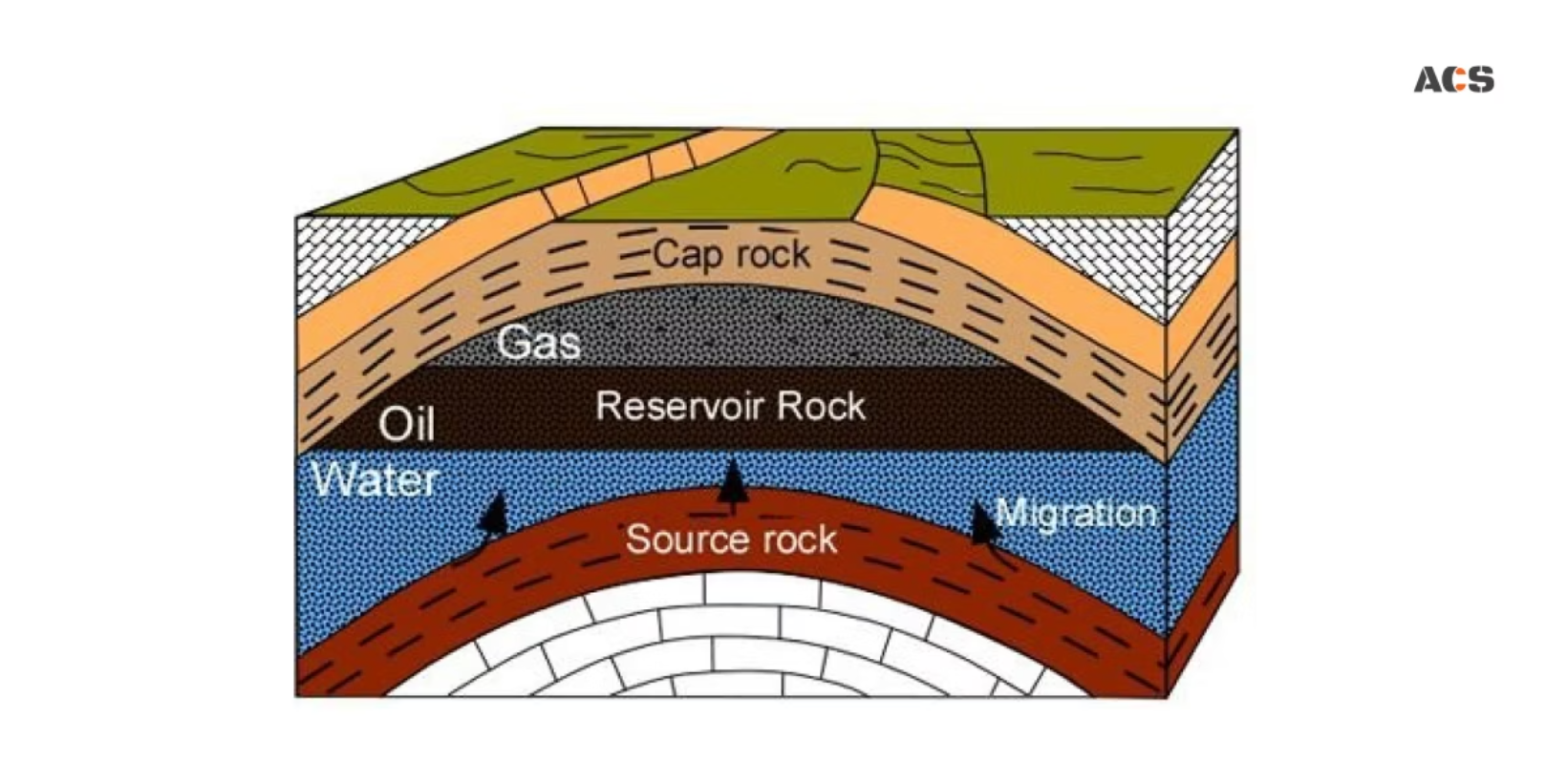
Introduction to Reservoir Simulation
Reservoir simulation predicts hydrocarbon reservoir behavior using mathematical models of fluid flow through porous rock. It helps engineers understand production rates and optimize recovery strategies.
Traditional simulations involve complex partial differential equations, considering rock and fluid properties, but are computationally expensive.
Proxy models offer a simplified, computationally efficient alternative, enabling rapid forecasting and scenario evaluation.

Slide 3
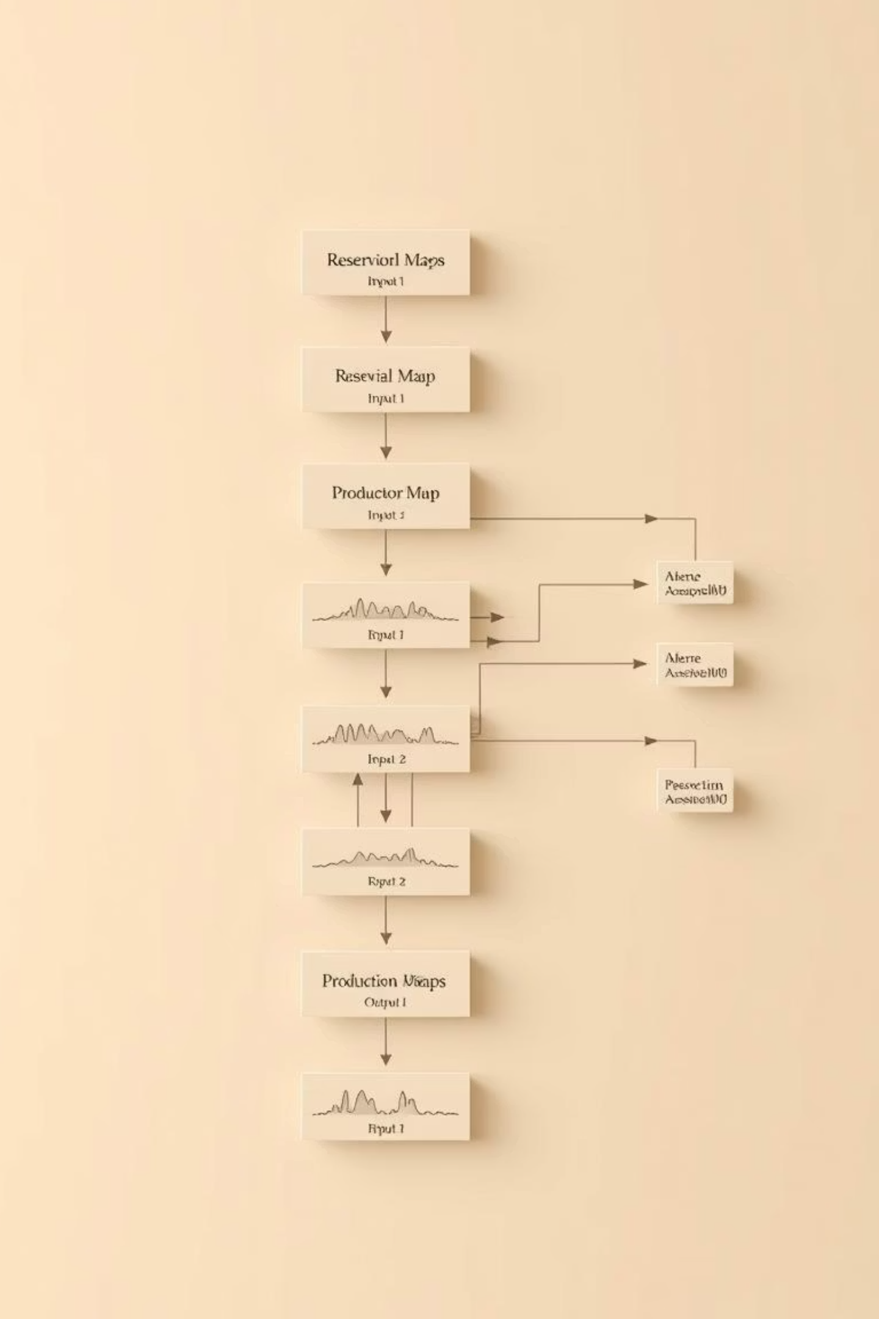
Project Overview: Deep Learning Proxy Model
This project develops a deep learning proxy model for reservoir production forecasting, leveraging deep neural networks and image processing.
1
Objective
Accurately predict oil production rates and cumulative production from reservoir property maps.
2
Benefit
Provide near-instantaneous forecasts, significantly reducing computational time compared to traditional methods.

Slide 4
Data & Methodology
Dataset
Process
1,050 reservoir model samples.
Permeability and porosity maps (64x64 TIFF grids).
Data Preprocessing
Excel file with oil rates, cumulative production (6 time periods), and initial water saturation (Sw).
Extract and process TIFF maps, apply normalization, and handle tabular data. Split into training, validation, and testing sets.
Inputs & Targets
Model Evaluation & Optimization
Inputs: Permeability map, Porosity map, Initial Sw.
Targets: Oil production rates and cumulative oil production on the 1st day of months 1, 3, 5, 7, 9, 11.
Evaluate performance using regression metrics. Iterate and refine for practical utility.
Documentation & Presentation
Thoroughly document all steps, architecture, and results. Showcase technical implementation and practical value.

Slide 5




Learning Objectives & Impact
This project integrates deep learning, image processing, and petroleum engineering principles.
Hands-on Experience
Multi-modal Data
Gain practical experience with proxy modeling techniques.
Handle image and scalar inputs in neural networks.
Practical Challenges
Problem Solving
Understand ML solution development for engineering.
Leverage cutting-edge techniques for real-world problems.
Successful completion bridges advanced machine learning with practical engineering applications.

Slide 6
Process
1. Importing Essential Libraries
At the first part of this project we must import Python libraries for various stages of deep learning model development, from data handling to hyperparameter tuning and visualization. Each library plays a critical role in building a robust reservoir production forecasting system.
Core Components
Data & Numerical Ops: pandas for DataFrames, numpy for array computations, and os for file management.
Deep Learning: tensorflow and keras API for NN building, training, and evaluation (e.g., Conv2D, Dense, Dropout layers, EarlyStopping).
Data Preprocessing: scikit-learn for train_test_split and MinMaxScaler for data normalization.

Slide 7

Core Components
Visualization: matplotlib.pyplot and seaborn for plotting data and model results.
Image Processing: PIL (Pillow) for handling TIFF image files (e.g., seismic data, well logs).
Hyperparameter Tuning: optuna for automated optimization.
Metrics: sklearn.metrics for calculating performance metrics like MAE, MSE, and R2 score.
The efficient management of these libraries ensures seamless workflow from data ingestion to predictive modeling, crucial for accurate reservoir production forecasting.

Slide 8
2. Loading the Dataset
The brief tabular data from data.xlsx is loaded into a pandas DataFrame named data. This provides a structured view of our production metrics.
data = pd.read_excel('./assets/data.xlsx')data.head()
sample number
Month (2026)
Initial Sw
Oil Rate (m3/day)
Cumulative Oil (M m3)
1
1
0.25
980.04
0.000681
1
3
0.25
410.07
25.471000
1
5
0.25
397.78
49.735000
1
7
0.25
388.08
73.408000
1
9
0.25
379.36
96.928000

Slide 9
3. Data Exploration and Validation
An initial Exploratory Data Analysis (EDA) is performed to understand the dataset's structure, quality, and statistical properties. This helps identify missing values and check data types.
.isna().sum(): Counts missing values per column, crucial for identifying data quality issues.
data.isna().sum()
sample number 0
Month (2026) 0
Initial Sw 18
Oil Rate (m3/day) 18
Cumulative Oil (M m3) 19
dtype: int64

Slide 10
.describe(): Provides a statistical summary of numerical columns, offering insights into distribution and scale.
data.describe()
sample number
Month (2026)
Initial Sw
Oil Rate (m3/day)
Cumulative Oil (M m3)
count
6300.000000
6300.000000
6282.000000
6282.000000
6281.000000
mean
525.500000
6.000000
0.214938
1423.594093
197.630083
std
303.132813
3.415921
0.028712
2813.436016
501.371992
min
1.000000
1.000000
0.170000
-145.740000
0.000000
25%
263.000000
3.000000
0.190000
345.830000
16.166000
50%
525.500000
6.000000
0.210000
809.145000
85.372000
75%
788.000000
9.000000
0.240000
1423.175000
214.100000
max
1050.000000
11.000000
0.260000
25000.000000
6256.200000

Slide 11
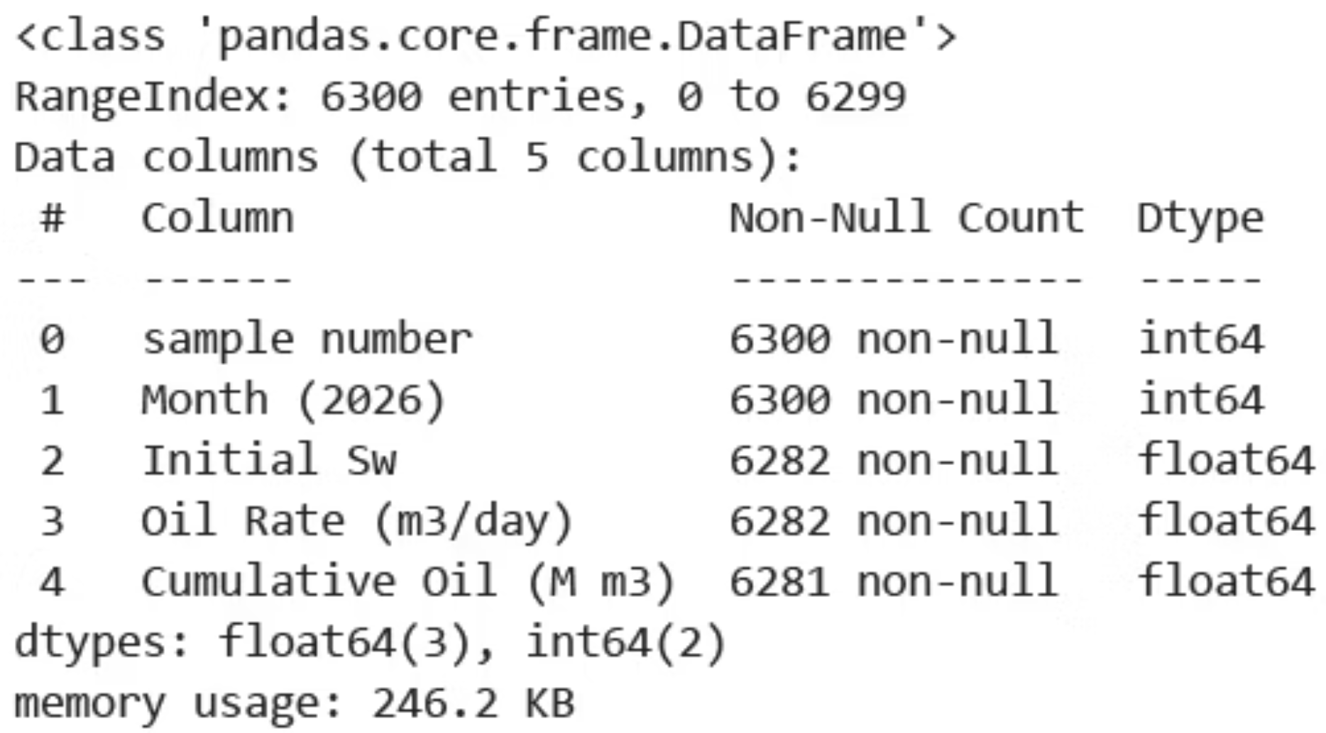
.info(): Summarizes DataFrame structure, including column data types and non-null counts.
data.info()

Slide 12
4. Data Preprocessing and Reshaping (For Numerical Data)
To ensure consistency with available porosity image maps, the initial DataFrame is filtered to include only the first 756 samples. The data, originally in a long format with six monthly entries per sample, is then reshaped into a wide format using pivot_table. This creates a single row per sample, with 12 new columns for Oil Rate and Cumulative Oil across six months. To align with our image data requirements and ensure model compatibility, we rigorously preprocess the tabular reservoir production data. This involves filtering, reshaping, and imputing missing values to create a clean, consistent dataset.
The dataset is truncated to include only the first 756 samples, matching the availability of porosity image maps. This ensures a one-to-one correspondence between tabular and image data.
num_available_samples = 756
df_filtered = data[data['sample number'] <= num_available_samples].copy()

Slide 13
Brief of processed tabular data
sample number | Cumulative Oil (M m3)_1 | Cumulative Oil (M m3)_3 | Cumulative Oil (M m3)_5 | Cumulative Oil (M m3)_7 | Cumulative Oil (M m3)_9 | Cumulative Oil (M m3)_11 | Oil Rate (m3/day)_1 | Oil Rate (m3/day)_3 | Oil Rate (m3/day)_5 | Oil Rate (m3/day)_7 | Oil Rate (m3/day)_9 | Oil Rate (m3/day)_11 | Initial Sw
1 | 0.000681 | 25.471 | 49.735 | 73.408 | 96.928 | 119.58 | 980.04 | 410.07 | 397.78 | 388.08 | 379.36 | 371.3 | 0.25
2 | 0.003307 | 118.83 | 218.46 | 302.95 | 378.49 | 444.91 | 4762.3 | 1828 | 1578.2 | 1385 | 1218.4 | 1088.8 | 0.23
3 | 0.001104 | 45.529 | 87.461 | 127.69 | 167.11 | 204.59 | 1590 | 725.02 | 687.42 | 659.53 | 635.76 | 614.49 | 0.21
4 | 0.003663 | 138.67 | 259.88 | 369.82 | 470.76 | 558.22 | 5274.3 | 2199.3 | 1987.1 | 1802.2 | 1628.1 | 1433.7 | 0.25
5 | 0.000214 | 9.7412 | 19.257 | 28.656 | 38.117 | 47.345 | 307.56 | 159.06 | 156 | 154.09 | 152.59 | 151.28 | 0.22

Slide 14
Reshaping to Wide Format
Handling Missing Values
Original data, structured in a "long" format with six monthly entries per sample, is reshaped using pivot_table. This transformation yields a "wide" format, where each sample corresponds to a single row with 12 distinct columns for Oil Rate and Cumulative Oil across six-time steps.
Post-pivot, column names are simplified, and any remaining missing values are addressed via mean imputation. While more complex methods exist, mean imputation was chosen for its simplicity and to avoid pre-normalization. A final check confirms data cleanliness.
for col in data_pivot.columns:
if data_pivot[col].isnull().any(): mean_val = data_pivot[col].mean() data_pivot[col].fillna(mean_val, inplace=True)
data_pivot = df_filtered.pivot_table(
index='sample number’,
columns='Month (2026)’,
values=['Oil Rate (m3/day)', 'Cumulative Oil (M m3)'])
This meticulous preprocessing step ensures our tabular data is precisely aligned and ready for integration with the image-based features, forming a robust foundation for our predictive model.

Slide 15

Data Validation & Insights
After preprocessing, it’s critical to validate the dataset's integrity. We verify dimensions and confirm the absence of missing values, revealing key insights into our data completeness.
Dataset Dimensions: The final DataFrame comprises 753 rows and 14 columns. The reduction from 756 initial samples confirms that 3 samples were entirely absent from the original tabular data.
Image Alignment Requirement: The observed 3 missing tabular samples necessitate a corresponding removal of their image data to maintain perfect alignment between the two modalities. This cross-validation is critical for model accuracy.
Cleanliness Confirmation: A final check using .isna().sum() verifies that the pivoted and imputed data is entirely free of missing values, making it ready for the next phase of modeling.
"Garbage in, garbage out" - Ensuring data quality at every step is paramount for reliable reservoir performance predictions.
This validation ensures that our prepared tabular data forms a reliable and consistent foundation, ready for integration with the image features and subsequent machine learning tasks.

Slide 16
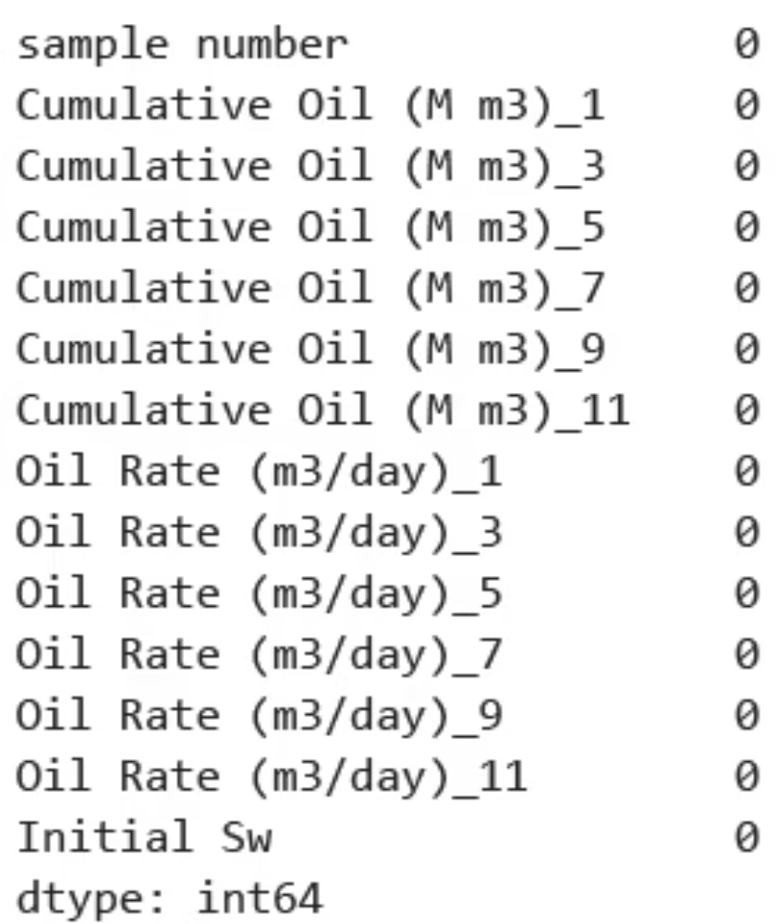
data_pivot.shape
(753, 14)
Finally, another check for missing values confirms that the pivoted and imputed data is clean and ready for the next stage.
data_pivot.isna().sum()

Slide 17
Two Approaches to Outlier Management
Post-Training Outlier Handling (main project)
Pre-Training Outlier Removal (side poroject)
Train on full dataset, then implement outlier detection/handling during inference.
Remove anomalous data points from the training dataset before model development.
Model sees complete data distribution during training
Ensures model learns from cleaner, more representative patterns
Can apply confidence thresholds or ensemble techniques to flag predictions on outlier inputs
Often employs statistical methods (z-score, IQR) or density-based approaches (DBSCAN, isolation forests)
Preserves information about data boundaries and edge cases
Risk: Model may be biased by extreme values during training
Reduces noise in gradient calculations during optimization
Risk: May discard valuable edge cases that represent real-world scenarios
Both approaches require careful validation with domain experts to distinguish between true anomalies and rare but valid data points. The optimal strategy often depends on your specific dataset characteristics and business requirements.

Slide 18

Understanding Outliers in Our Dataset
*This step has just used for side project
Why Outlier Detection Matters
Key Stats
Outliers can significantly skew model training, especially when working with:
Original dataset: 753 samples
Time-series data like our 12 target variables
Detected outliers: 45 samples (6%)
Rate-based measurements (Oil Rate)
Cleaned dataset: 708 samples
Cumulative calculations that amplify anomalies
Our experimental approach helps determine whether removing statistical outliers improves model performance on this particular dataset.
We'll examine the boxplot visualization technique, apply the IQR method programmatically, then verify our results with a second visualization.
*Each step which has a sign of prime (" ' "), it's for side project on the other hand, it's for main project

Slide 19
Understanding Outliers in Our Dataset
1. Initial Visualization: Identifying Outliers with Boxplots
Visualization Process
Observations
Generated boxplots for all 12 target variables using seaborn's boxplot function with a figure size of 18×8 to accommodate all variables.
Points outside the whiskers represent statistical outliers
Oil Rate variables showed significant outliers
plt.figure(figsize=(18, 8)) sns.boxplot(data=df_targets_for_plot)
Cumulative Oil in later months contained extreme values
Y-axis scale was dominated by these extreme points

Slide 20
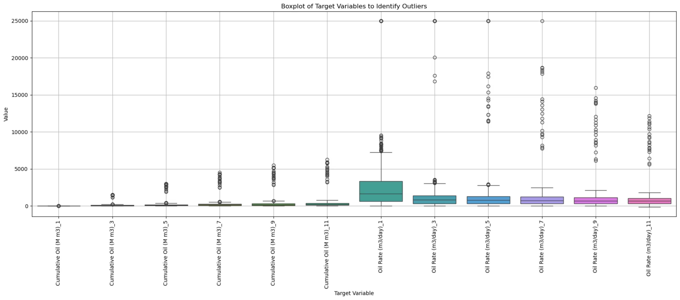
Understanding Outliers in Our Dataset
Before outliers removal

Slide 21


Understanding Outliers in Our Dataset
2. Programmatic Outlier Removal using the IQR Method
Define Boundaries
Calculate Quartiles & IQR
Set upper and lower bounds using the standard 1.5×IQR rule:
For each target variable:
lower_bound = Q1 - 1.5 * IQR upper_bound = Q3 + 1.5 * IQR
Q1 = data_pivot[col].quantile(0.25) Q3 = data_pivot[col].quantile(0.75) IQR = Q3 - Q1
Remove & Verify
Identify Outliers
Drop all identified outliers and confirm the new dataset size:
Flag samples outside boundaries in any target variable:
45 outliers removed (6% of data)
column_outliers = data_pivot[ (data_pivot[col] < lower_bound) | (data_pivot[col] > upper_bound) ].index
Original: 753 samples → Cleaned: 708 samples

Slide 22
Understanding Outliers in Our Dataset
3. Verifying Outlier Removal
Analysis of the Cleaned Dataset
Extreme values no longer present in the visualization
Y-axis rescaled to show finer distribution details
More concentrated data distribution visible in all 12 variables
Cleaner dataset ready for experimental model training
This cleaned dataset (n=708) can now be compared against the original dataset (n=753) in model training to evaluate the impact of outlier removal on prediction accuracy.

Slide 23
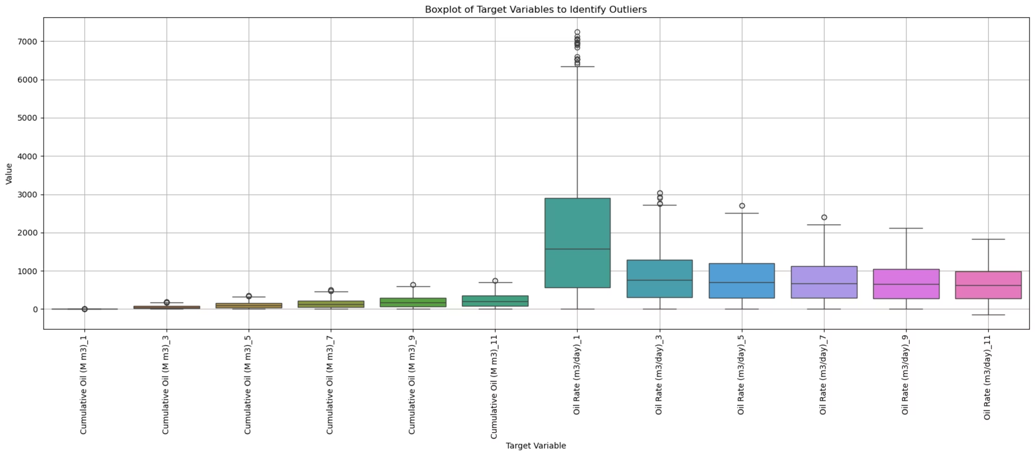
Understanding Outliers in Our Dataset
After outliers removal

Slide 24
5,5'. Loading and Stacking Image Data (Image Data)
Our dataset consists of paired permeability and porosity TIFF maps for 756 reservoir samples. The processing pipeline:
Convert to Arrays
Load Raw Images
Transform image files into NumPy arrays with float32 precision
Import permeability and porosity TIFF files from their respective directories
Create Final Dataset
Stack Channels
Combine all samples into a single 4D array of shape (756, 64, 64, 2)
Combine paired maps into single (64, 64, 2) arrays using np.stack

Slide 25
6. Aligning Tabular and Image Datasets
Data Mismatch Challenge
Synchronization Solution
Final Dataset Structure
Identified discrepancy: 756 image samples vs. 753 tabular records in the Excel file
Extract valid sample numbers from tabular data and filter image array to remove orphaned samples
X_image: filtered reservoir maps (753, 64, 64, 2)
X_numerical: 'Initial Sw' values (753, 1)
y: 12 target production variables (753, 12)
The alignment process ensures all samples have corresponding image and tabular data, preventing errors during model training and evaluation.

Slide 26
6'. Aligning Tabular and Image Datasets
Data Mismatch Challenge
Synchronization Solution
Final Dataset Structure
Identified discrepancy: 756 image samples vs. 753 tabular records in the Excel file
Extract valid sample numbers from tabular data and filter image array to remove orphaned samples
X_image: filtered reservoir maps (708, 64, 64, 2)
X_numerical: 'Initial Sw' values (708, 1)
y: 12 target production variables (708, 12)
The alignment process ensures all samples have corresponding image and tabular data, preventing errors during model training and evaluation.

Slide 27

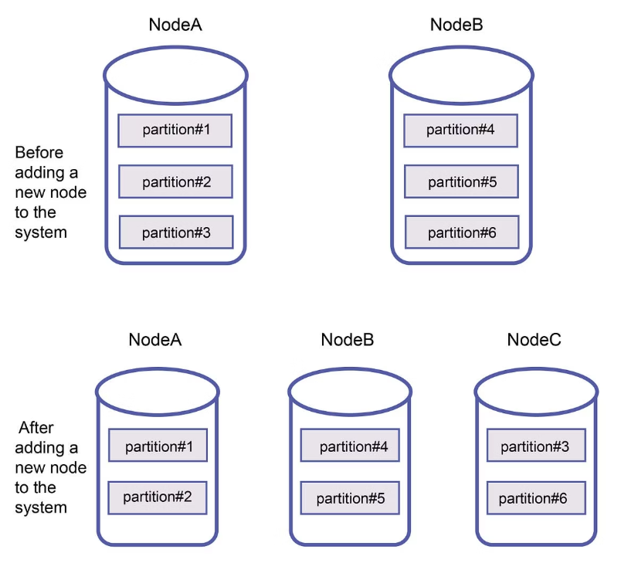
7. Data Partitioning Strategy
We employ a two-stage splitting approach to create properly balanced datasets:
1
2
3
Initial Split
Secondary Split
Final Distribution
Separate 15% of data as test set using train_test_split with random_state=42
Divide remaining 85% into training (70.6%) and validation (14.4%) sets
Training: 527 samples (70%)
Validation: 113 samples (15%)
The validation size is calculated as 0.1765 of the remaining data (0.15/0.85)
Testing: 113 samples (15%)

Slide 28

7'. Data Partitioning Strategy
We employ a two-stage splitting approach to create properly balanced datasets:
1
2
3
Initial Split
Secondary Split
Final Distribution
Separate 15% of data as test set using train_test_split with random_state=42
Divide remaining 85% into training (70.6%) and validation (14.4%) sets
Training: 494 samples (70%)
Validation: 107 samples (15%)
The validation size is calculated as 0.1765 of the remaining data (0.15/0.85)
Testing: 107 samples (15%)

Slide 29
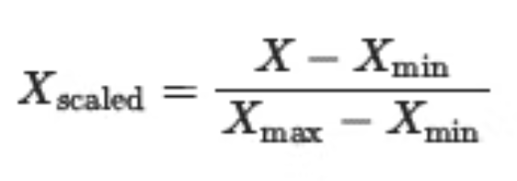
8,8'. Data Range Analysis and Normalizing
Normalization Methodology
We implement proper normalization to scale all values to [0,1] range while preventing data leakage:
Tabular Data Scaling
Image Data Scaling
NaN Handling
Applied MinMaxScaler to target variables (y) and numerical input (Initial Sw)
Implemented channel-wise normalization with manual min-max scaling:
Applied np.nan_to_num to replace NaN values with zeros
Fit scalers on training data only
X_scaled = (X - X_train_min) / (X_train_max - X_train_min)
This ensures numerical stability during model training
Apply the same fitted scalers to transform validation and test sets
This preserves the unique statistical distribution of each physical property
This approach maintains the integrity of our test sets as truly unseen data while ensuring consistent scaling across all datasets.

Slide 30



8. Data Range Analysis and Normalizing
Before normalization, we assessed the value ranges across all datasets to understand scaling requirements:
Image Data
Numerical Data
Target Values
Training: nan to nan (permeability)
Initial Sw ranges consistently across all sets:
Training: ~0 to 25000.0
Validation: 0 to 11547.098
Validation: -145.74 to 25000.0
Test: 0 to 13316.762
Min: 0.17
Test: ~0 to 25000.0
Max: 0.26
The significant range differences between features confirmed the need for normalization to ensure all inputs contribute effectively during model training.

Slide 31
8'. Data Range Analysis and Normalizing
Before normalization, we assessed the value ranges across all datasets to understand scaling requirements:
Image Data
Numerical Data
Target Values
Training: 0 to inf (permeability)
Initial Sw ranges consistently across all sets:
Training: -145.74 to 7249.2
Validation: nan to nan
Validation: ~0 to 6900.7
Test: 0 to 277.761
Min: 0.17
Test: ~0 to 7044.4
Max: 0.26
The significant range differences between features confirmed the need for normalization to ensure all inputs contribute effectively during model training.

Slide 32

8. Data Range Analysis and Normalizing
Normalization Results
Image Data (Post-Scaling)
Target Variables (Post-Scaling)
Training set: [0.0, 1.0]
All sets successfully scaled to [~0, 1.0] range
Test set: [0.0, 0.9875]
Note the slight range variations in test/validation sets. This is expected behavior when applying training-derived scaling parameters to unseen data distributions.
Validation set: [0.0, 0.8562]
Numerical Data (Post-Scaling)
All sets successfully scaled to [0.0, 1.0] range

Slide 33

8'. Data Range Analysis and Normalizing
Normalization Results
Image Data (Post-Scaling)
Target Variables (Post-Scaling)
Training set: [0.0, 1.0]
Training set: [0.0, 1.0]
Test set: [0.0, 1.0001]
Test set: [0.0004, 1.0178]
Validation set: [0.0, 0.9998]
Validation set: [-0.0001, 0.9519]
Numerical Data (Post-Scaling)
Note the slight range variations in test/validation sets. This is expected behavior when applying training-derived scaling parameters to unseen data distributions.
All sets successfully scaled to [0.0, 1.0] range

Slide 34
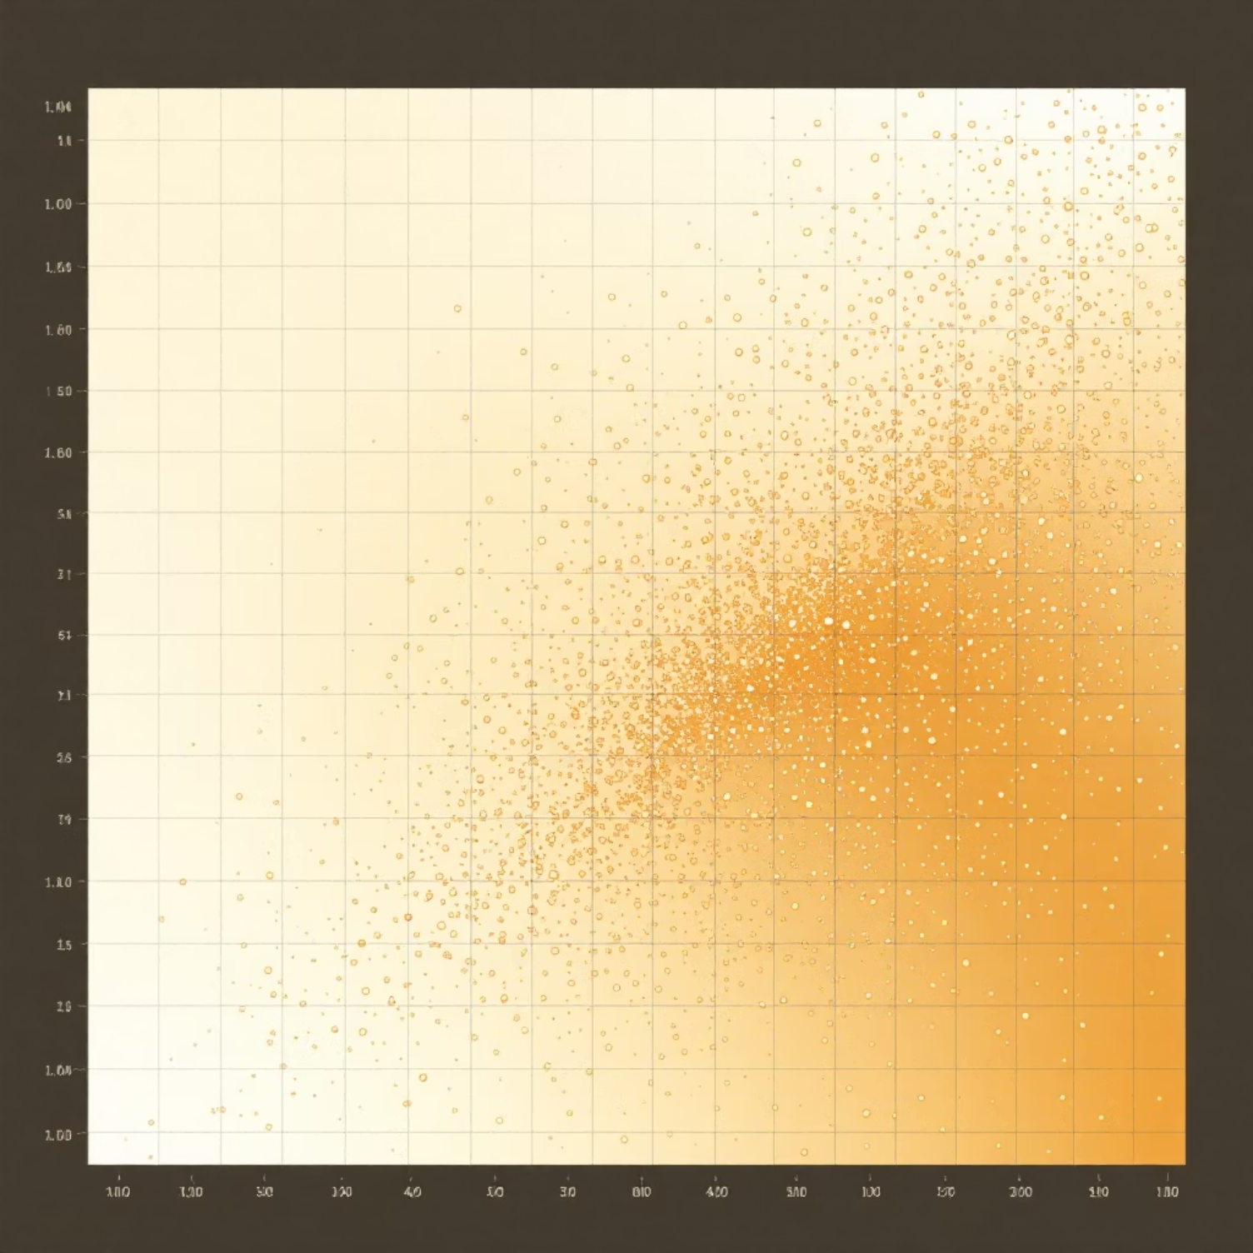
9,9'.Feature Correlation Analysis
We analyzed Pearson correlations between all features to understand relationships between inputs and targets:
1
Correlation Visualization
Created a heatmap to visualize the strength and direction of relationships between all variables
Used 'coolwarm' color mapping with red indicating positive correlation and blue indicating negative correlation
2
Initial Sw Relationships
Extracted specific correlation values between our single numerical input feature (Initial Sw) and all target variables
This reveals which production metrics are most strongly influenced by initial water saturation
This analysis provides valuable insights into feature relationships but doesn't impact our feature selection strategy as we're using all available features in the model.

Slide 35
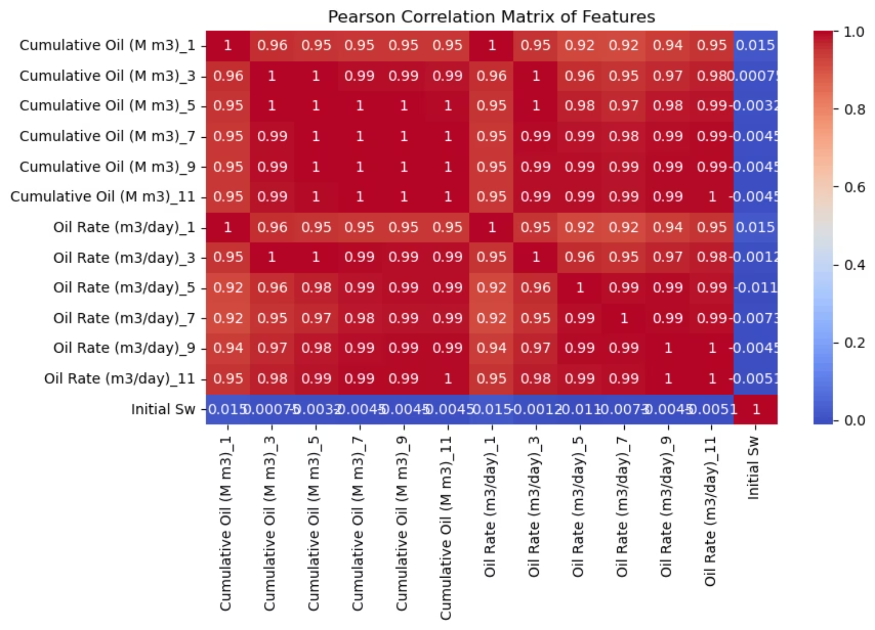
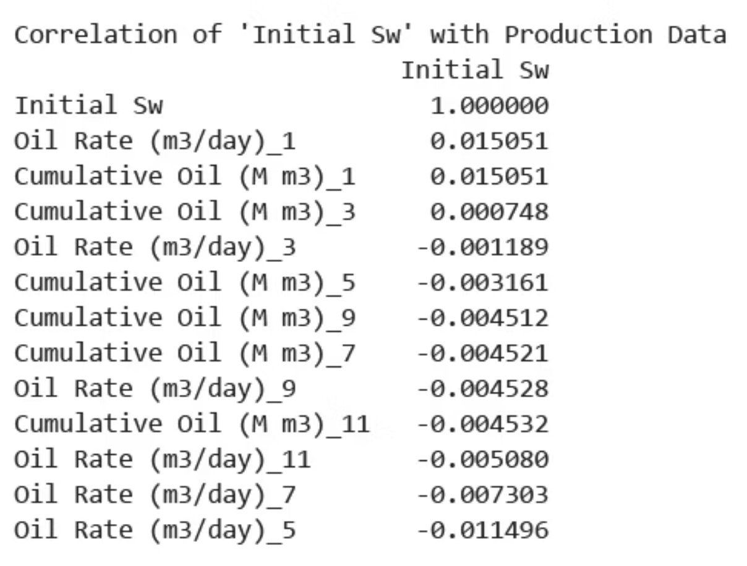
9.Visualizing Feature Correlations results

Slide 36
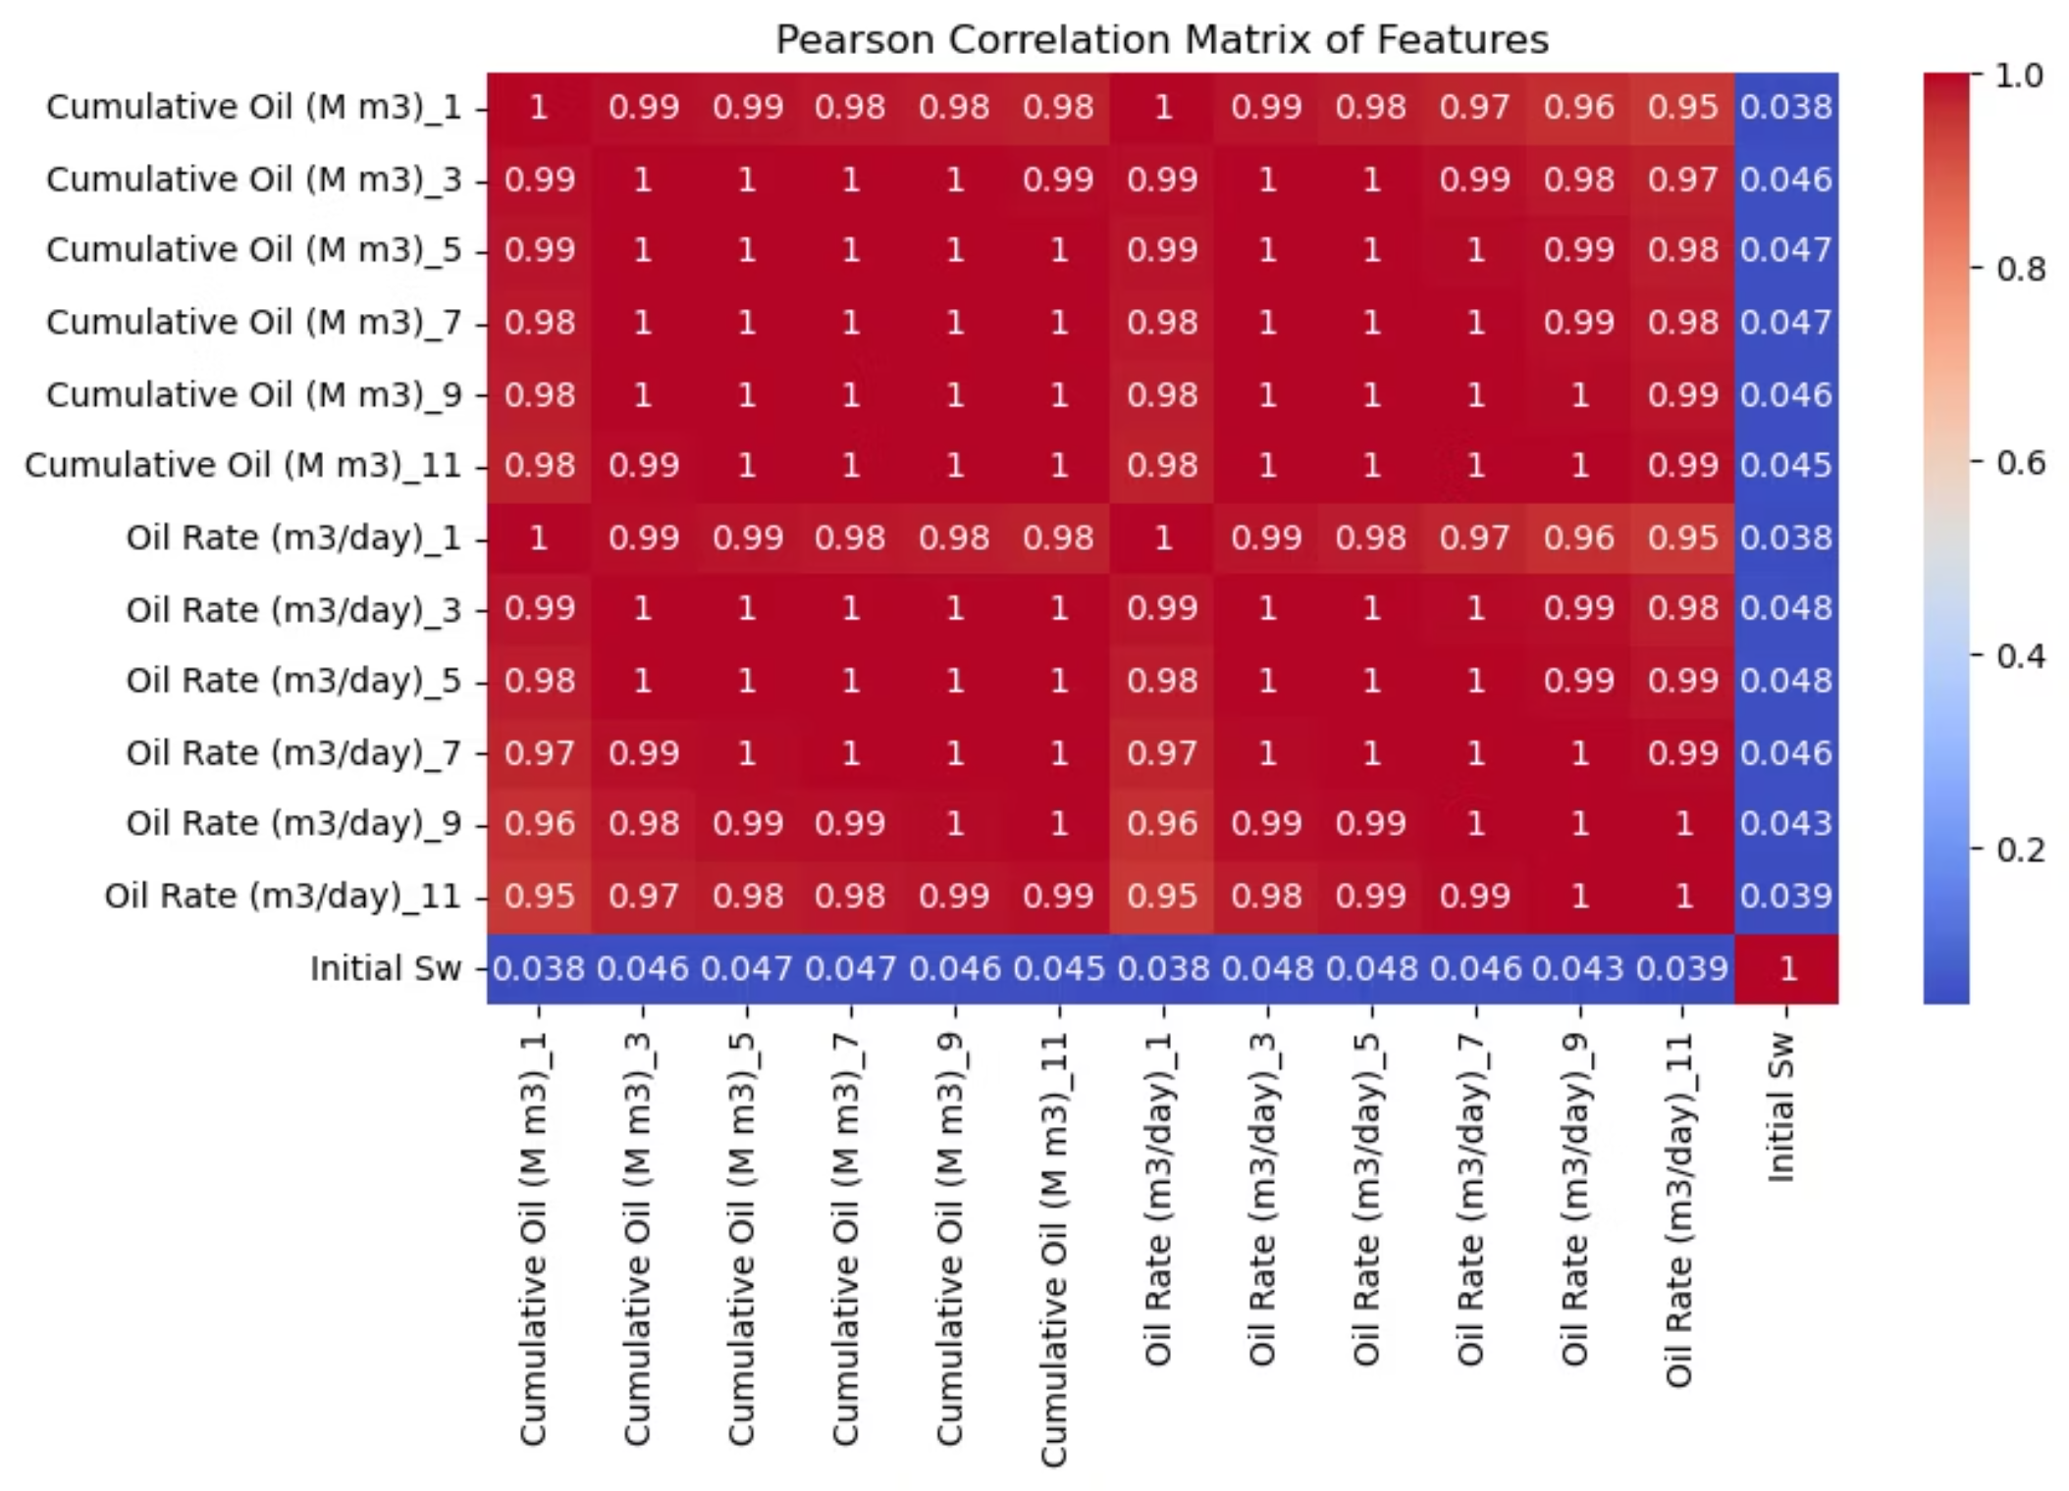
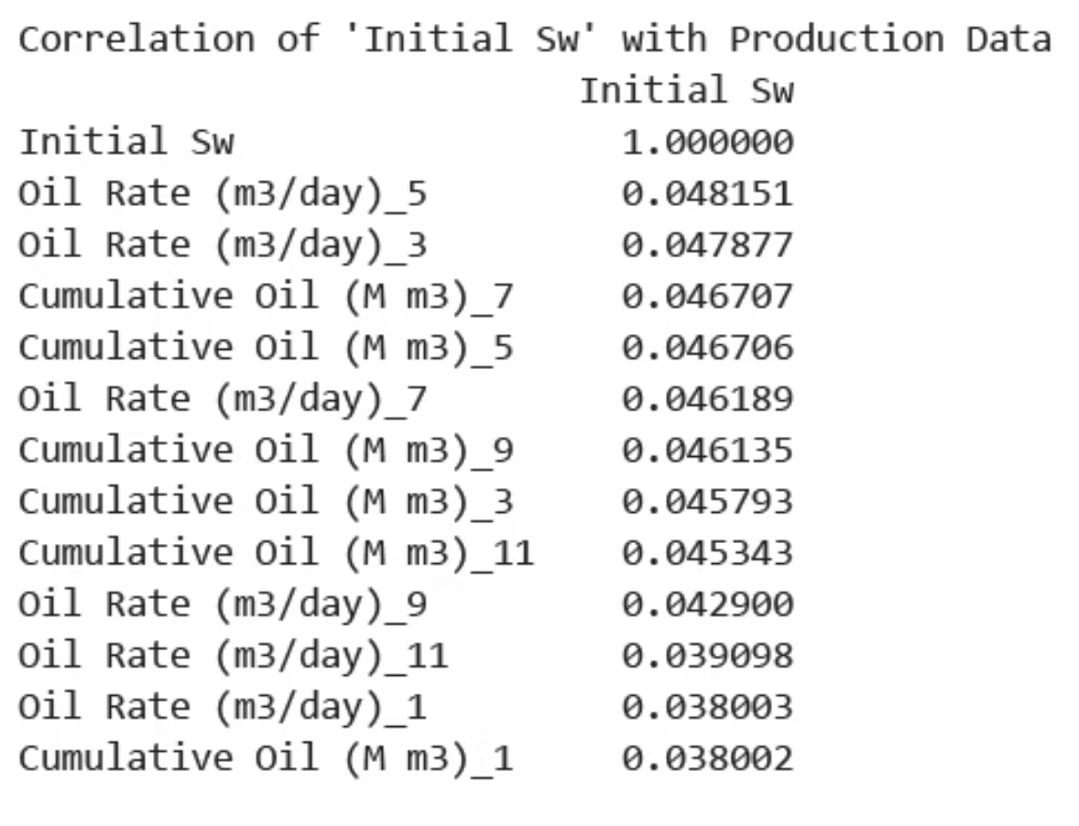
9'.Visualizing Feature Correlations results

Slide 37



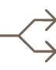
Key Takeaways
Data Synchronization
Multi-Channel Reservoir Imaging
Resolved dataset misalignment issues to ensure perfect correspondence between image and tabular data
Successfully combined permeability and porosity maps into a dual-channel 4D tensor (753, 64, 64, 2) for side project and (708, 64, 64, 2) for side project
Proper Normalization
Strategic Data Partitioning
Applied best-practice scaling techniques to prevent data leakage while ensuring consistent [0,1] ranges
Implemented a balanced 70/15/15 split for training, validation, and testing
This preprocessing pipeline provides a solid foundation for building advanced deep learning models that can effectively analyze reservoir characteristics and predict production outcomes.
Next steps: Implement CNN architecture to extract spatial features from reservoir maps and combine with Initial Sw data to predict the 12 target variables.

Slide 38
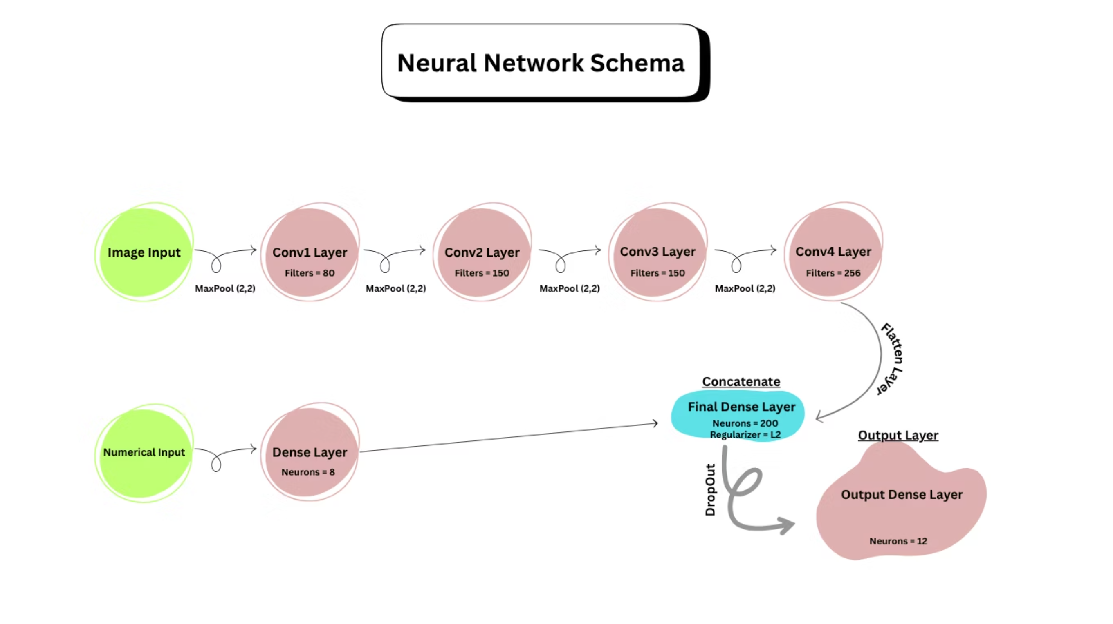
10,10'. Building the Final Optimized Model
Model Overview

Slide 39
10,10'. Building the Final Optimized Model
Model Overview
Architecture
Inputs
Output
Multi-branch CNN with convolutional layers for spatial features and dense layers for numerical processing
2-channel image data (64×64) and 1 numerical feature
12 regression targets predicted simultaneously
Our challenge was to build a model that could efficiently extract features from both image and numerical data, combining them to make accurate predictions across multiple targets.

Slide 40
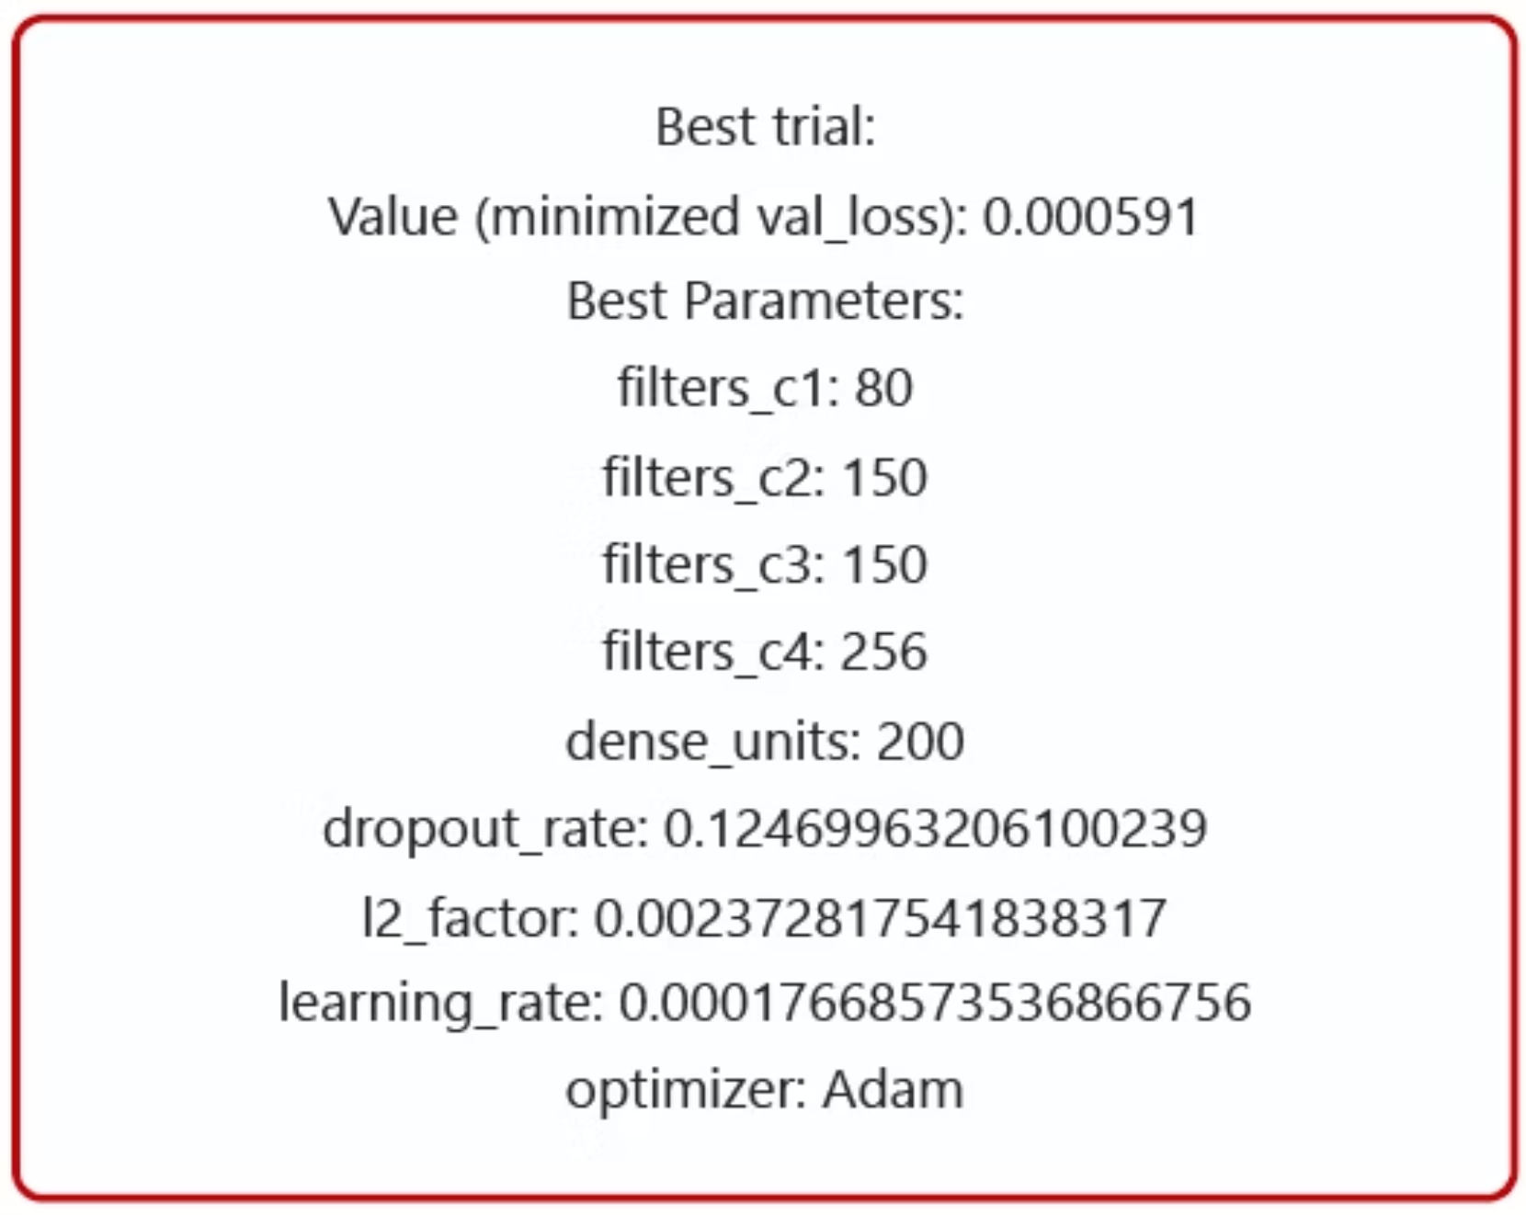
10. Building the Final Optimized Model
Hyperparameter Optimization Strategy
We leveraged Optuna for systematic hyperparameter tuning, searching through a complex parameter space to minimize validation loss.
After 100 trials, trial #31 emerged as the best performer with a validation loss of 0.00059.
Search Space Included:
Filter counts across 4 Conv2D layers
Dense layer unit counts
Regularization parameters (dropout, L2)
Learning rate and optimizer selection

Slide 41
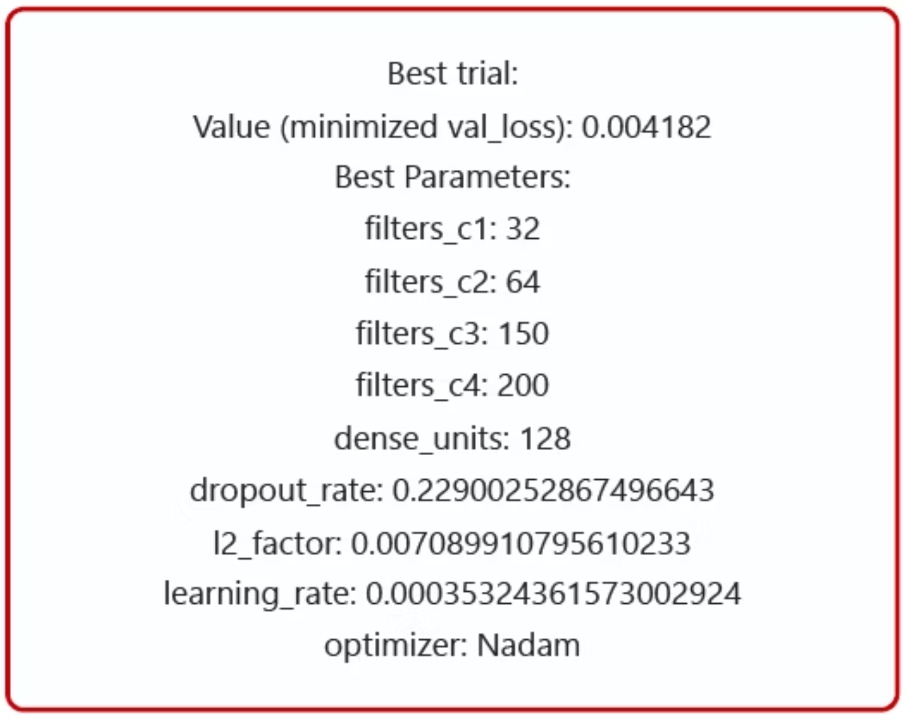
10'. Building the Final Optimized Model
Hyperparameter Optimization Strategy
We leveraged Optuna for systematic hyperparameter tuning, searching through a complex parameter space to minimize validation loss.
After 100 trials, trial #47 emerged as the best performer with a validation loss of 0.00418.
Search Space Included:
Filter counts across 4 Conv2D layers
Dense layer unit counts
Regularization parameters (dropout, L2)
Learning rate and optimizer selection

Slide 42
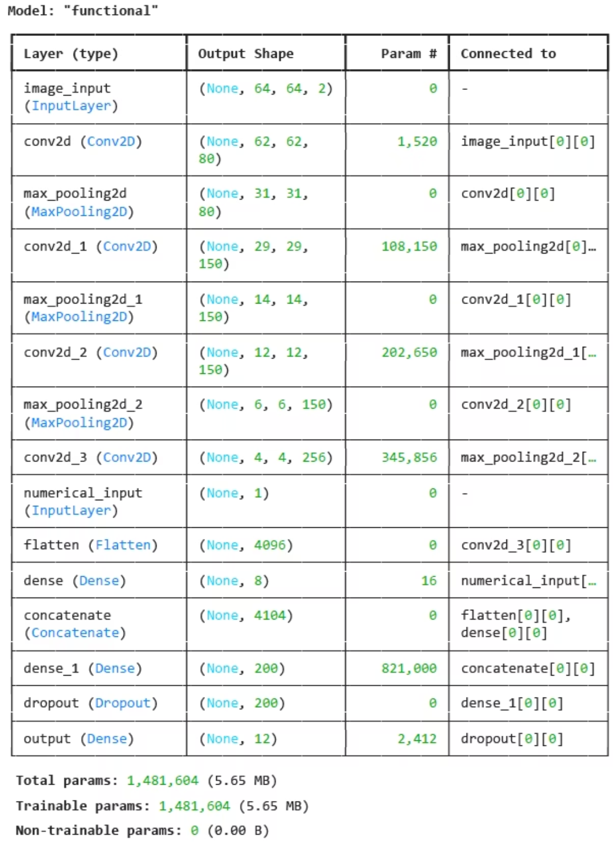
10. Building the Final Optimized Model
Model summary

Slide 43
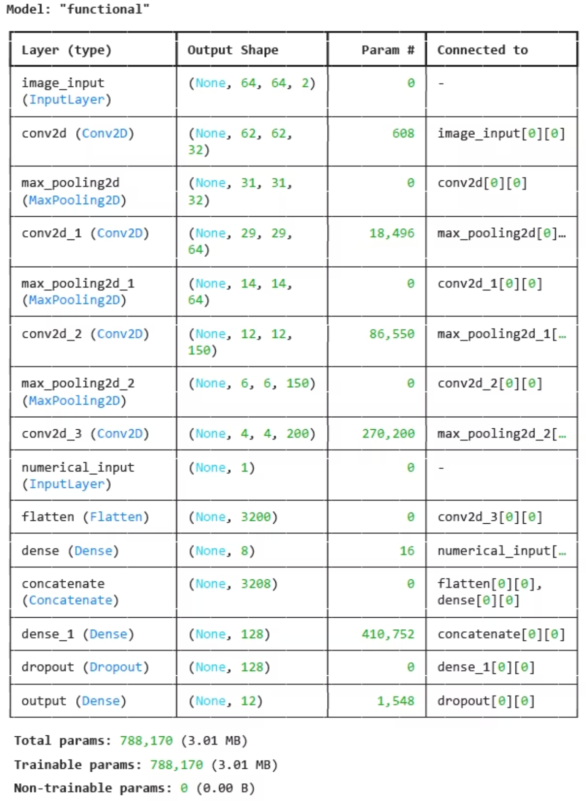
10'. Building the Final Optimized Model
Model summary

Slide 44





Numerical Input
CNN Branch
Output Layer
Concatenate
Image Input
Optimal Model Architecture
1
CNN Branch
2
Numerical Branch
Four Conv2D layers (80→150→150→256) filters for main project and Four Conv2D layers (32→64→150→200) filters for side project with SELU activation and MaxPooling, extracting increasingly complex spatial features
Small dense layer (8 units) to process the single numerical input feature
3
Feature Fusion
4
Final Processing
Concatenation layer merges flattened CNN features with numerical branch output
Dense layer (200 units) with L2 regularization (0.0024) and dropout (0.125), feeding into linear output layer with 12 units (for main project)
Dense layer (128 units) with L2 regularization (0.0071) and dropout (0.229), feeding into linear output layer with 12 units (for side project)

Slide 45
Best Hyperparameters from Optuna (for main project)
80
150
150
256
Filters C1
Filters C2
Filters C3
Filters C4
First Conv2D layer
Second Conv2D layer
Third Conv2D layer
Fourth Conv2D layer
200
12.5%
0.0024
0.00017
Dense Units
Dropout Rate
L2 Factor
Learning Rate
Final dense layer
For regularization
Weight regularization
For Aadam optimizer

Slide 46
Best Hyperparameters from Optuna (for side project)
32
64
150
200
Filters C1
Filters C2
Filters C3
Filters C4
First Conv2D layer
Second Conv2D layer
Third Conv2D layer
Fourth Conv2D layer
128
22.9%
0.0071
0.00035
Dense Units
Dropout Rate
L2 Factor
Learning Rate
Final dense layer
For regularization
Weight regularization
For Nadam optimizer

Slide 47
11,11'. Defining Callbacks and Compiling the Model
Training Strategy & Callbacks
Advanced Callbacks
Early Stopping
Reduce LR On Plateau
Monitored val_loss with patience=15
Monitored val_loss with patience=10
Restored best weights automatically
Reduction factor: 0.1
For main project training helted have not recognized, best weights from epoch 200
Minimum learning rate: 1e-5
For side project training halted at epoch 189, best weights from epoch 174

Slide 48

12,12'. Model Training
Training Results & Convergence
Training Configuration
Batch size: 32
epochs: 200
Optimizer:
Aadam with optimal learning rate (0.00017) (main project)
Nadam with optimal learning rate (0.00035) (side project)
Loss function: Mean Squared Error
Metrics: MAE, RMSE

Slide 49
13. Final Model Evaluation on the Test Set
Main project model Performance on Test Set
174.89
241,136
Our model achieved impressive performance on the completely unseen test set, explaining 97.9% of the variance in the target variables (R²=0.979).
MAE
MSE
To generate these metrics, we:
Mean Absolute Error
Mean Squared Error
Made predictions on scaled test inputs
Applied inverse scaling to convert predictions back to original units
491.06
0.979
Calculated standard regression metrics against ground truth
RMSE
R²
*These metrics has calculated after reverse scaling
Root Mean Squared Error
Coefficient of Determination

Slide 50
13'. Final Model Evaluation on the Test Set
Side project model Performance on Test Set
82.10
35,819
Our model achieved impressive performance on the completely unseen test set, explaining 93.3% of the variance in the target variables (R²=0.933).
MAE
MSE
To generate these metrics, we:
Mean Absolute Error
Mean Squared Error
Made predictions on scaled test inputs
Applied inverse scaling to convert predictions back to original units
189.26
0.933
Calculated standard regression metrics against ground truth
RMSE
R²
*These metrics has calculated after reverse scaling
Root Mean Squared Error
Coefficient of Determination

Slide 51
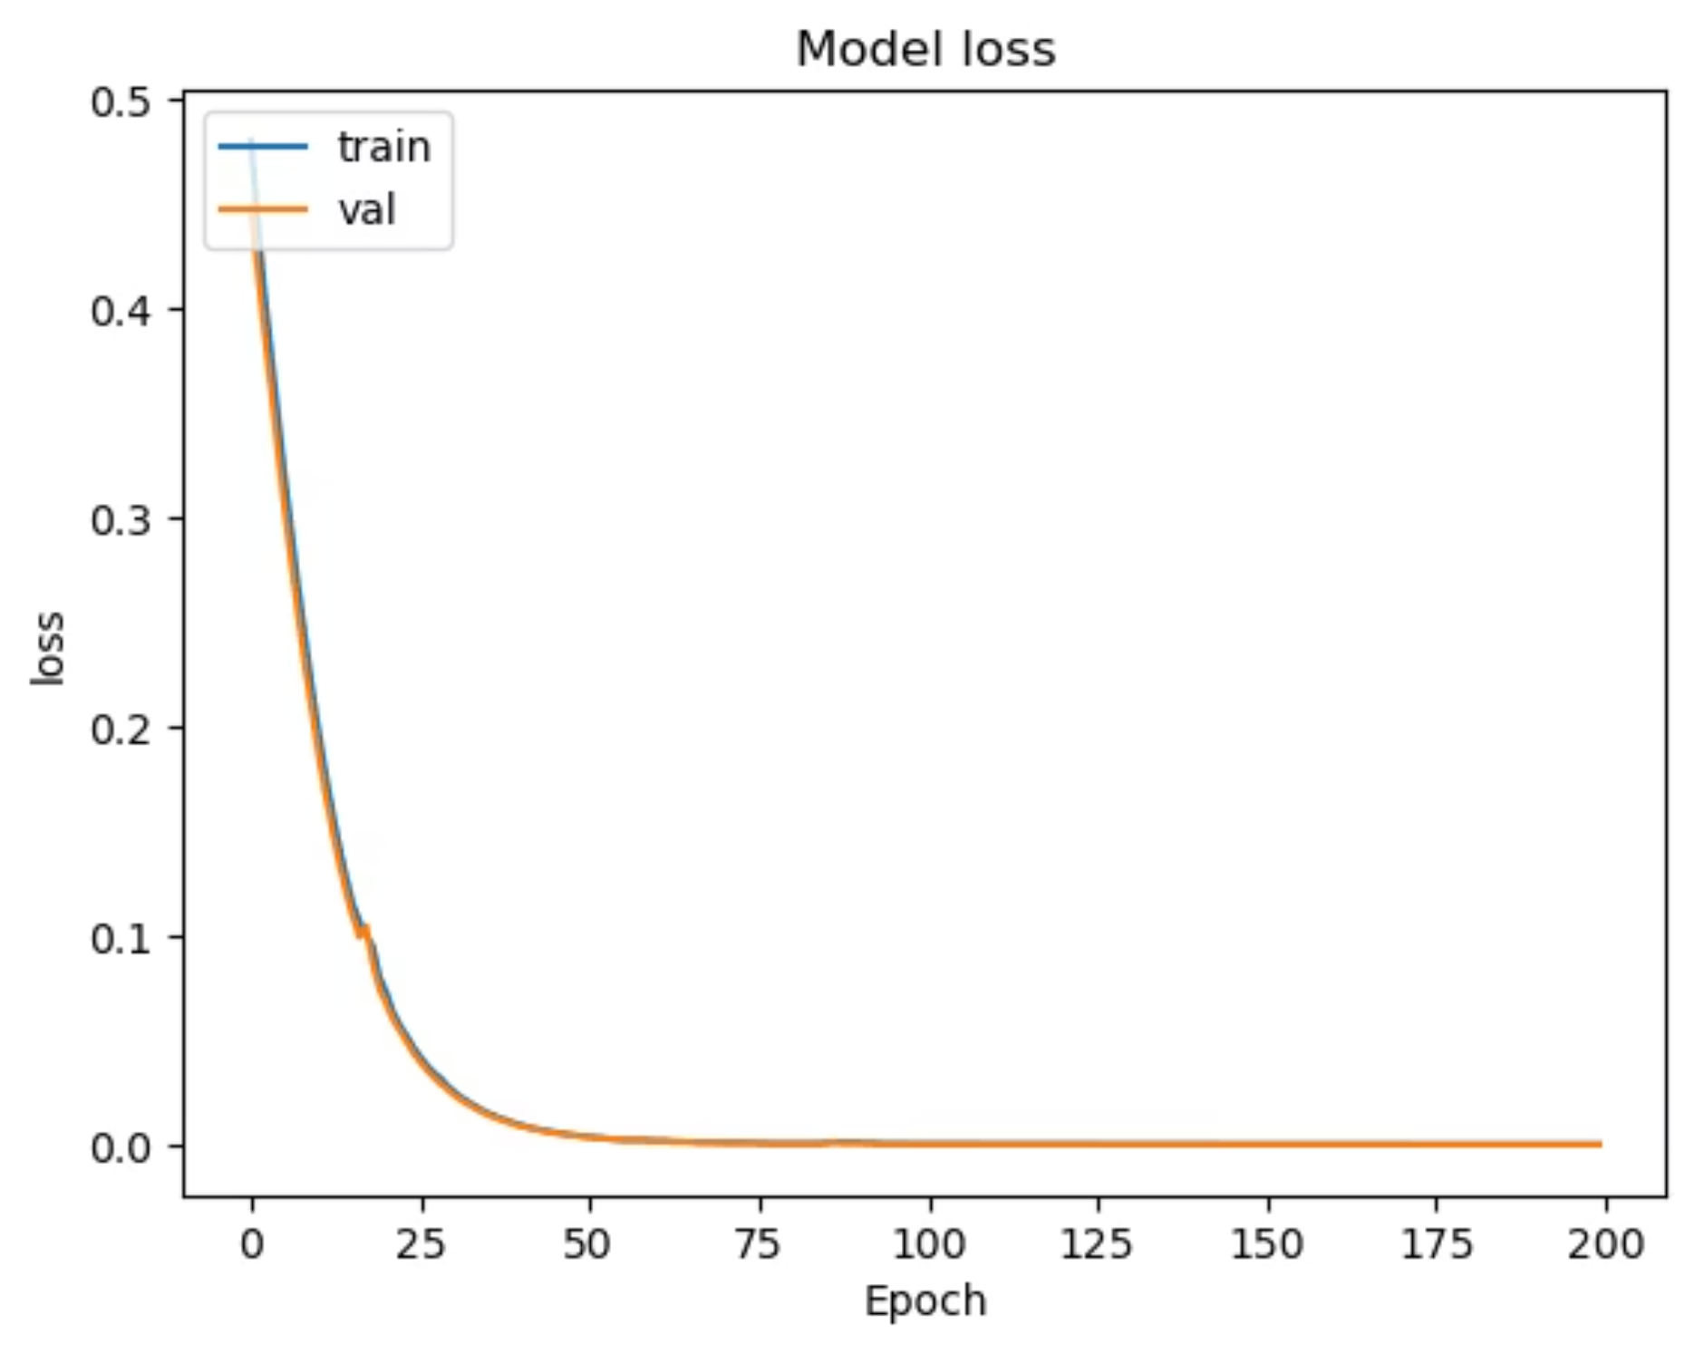
14. Visualizing Training History
Loss function of main project
The training process exhibited excellent convergence characteristics:
Smooth Learning Curve
Both training and validation loss decreased sharply and smoothly, eventually converging to very low error values
No Overfitting
The minimal and stable gap between training and validation loss curves indicates the model generalized well to unseen data
Effective Regularization
The combination of L2 regularization and dropout successfully prevented memorization of training data

Slide 52
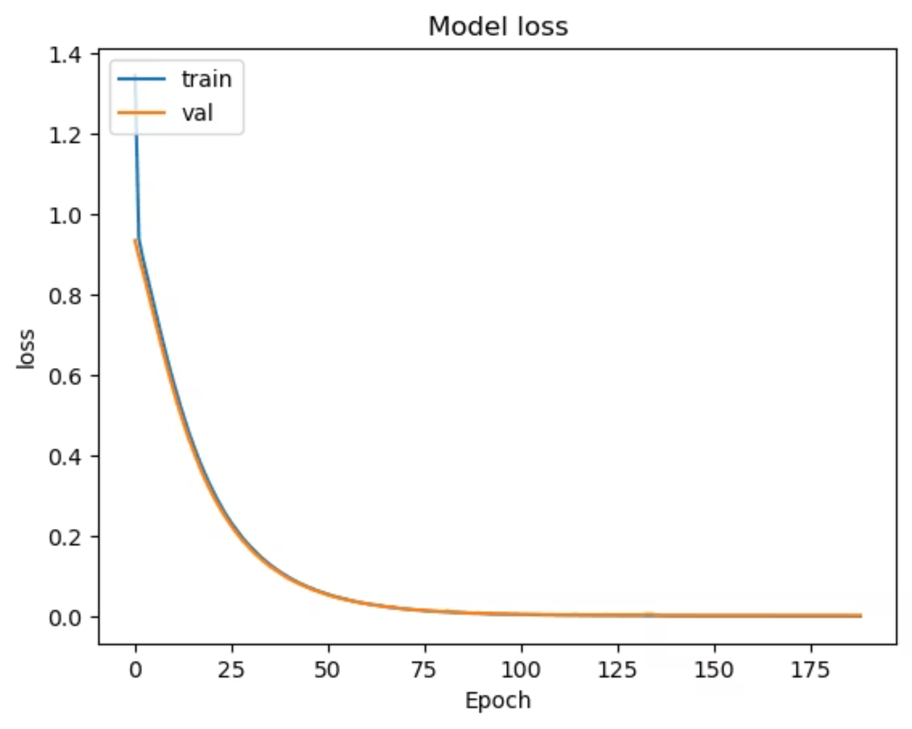
14'. Visualizing Training History
Loss function of side project
The training process exhibited excellent convergence characteristics:
Smooth Learning Curve
Both training and validation loss decreased sharply and smoothly, eventually converging to very low error values
No Overfitting
The minimal and stable gap between training and validation loss curves indicates the model generalized well to unseen data
Effective Regularization
The combination of L2 regularization and dropout successfully prevented memorization of training data

Slide 53
15. Model Validation and Visualization on unseen data
15.1 Actual vs. Predicted Analysis
Initial visual inspection and correlation assessment
15.2 Residual Analysis
Systematic patterns and outlier impact
15.3 Single Sample Case Study
Granular analysis of individual predictions
15.4 Outlier Removal Analysis
Performance assessment with and without outliers
15.5 Visualizing the Outlier Threshold
The threshold line effectively separates these few outlier predictions
15.6 Final Diagnostics
Validating model reliability and calibration

Slide 54

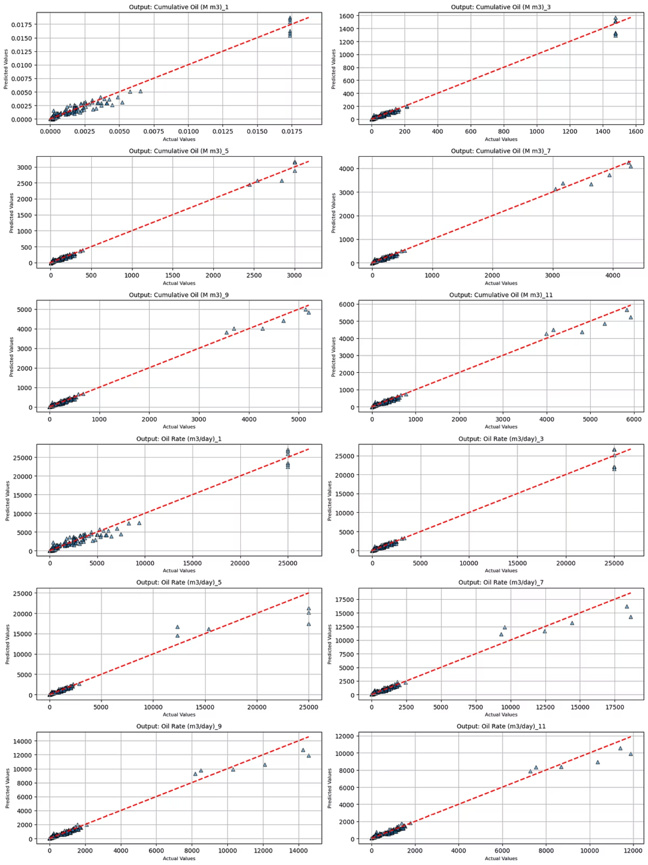
15.1 Actual vs. Predicted: Initial Analysis
Key Observations
Implications
While overall metrics (like R²) were very high, this visual inspection revealed that a few specific points might be disproportionately influencing the results, potentially masking the true performance on the majority of the data.
Strong linear correlation for all outputs
Most data points clustered tightly around the perfect prediction line
Several distinct outlier points visible with noticeably larger errors

Slide 55

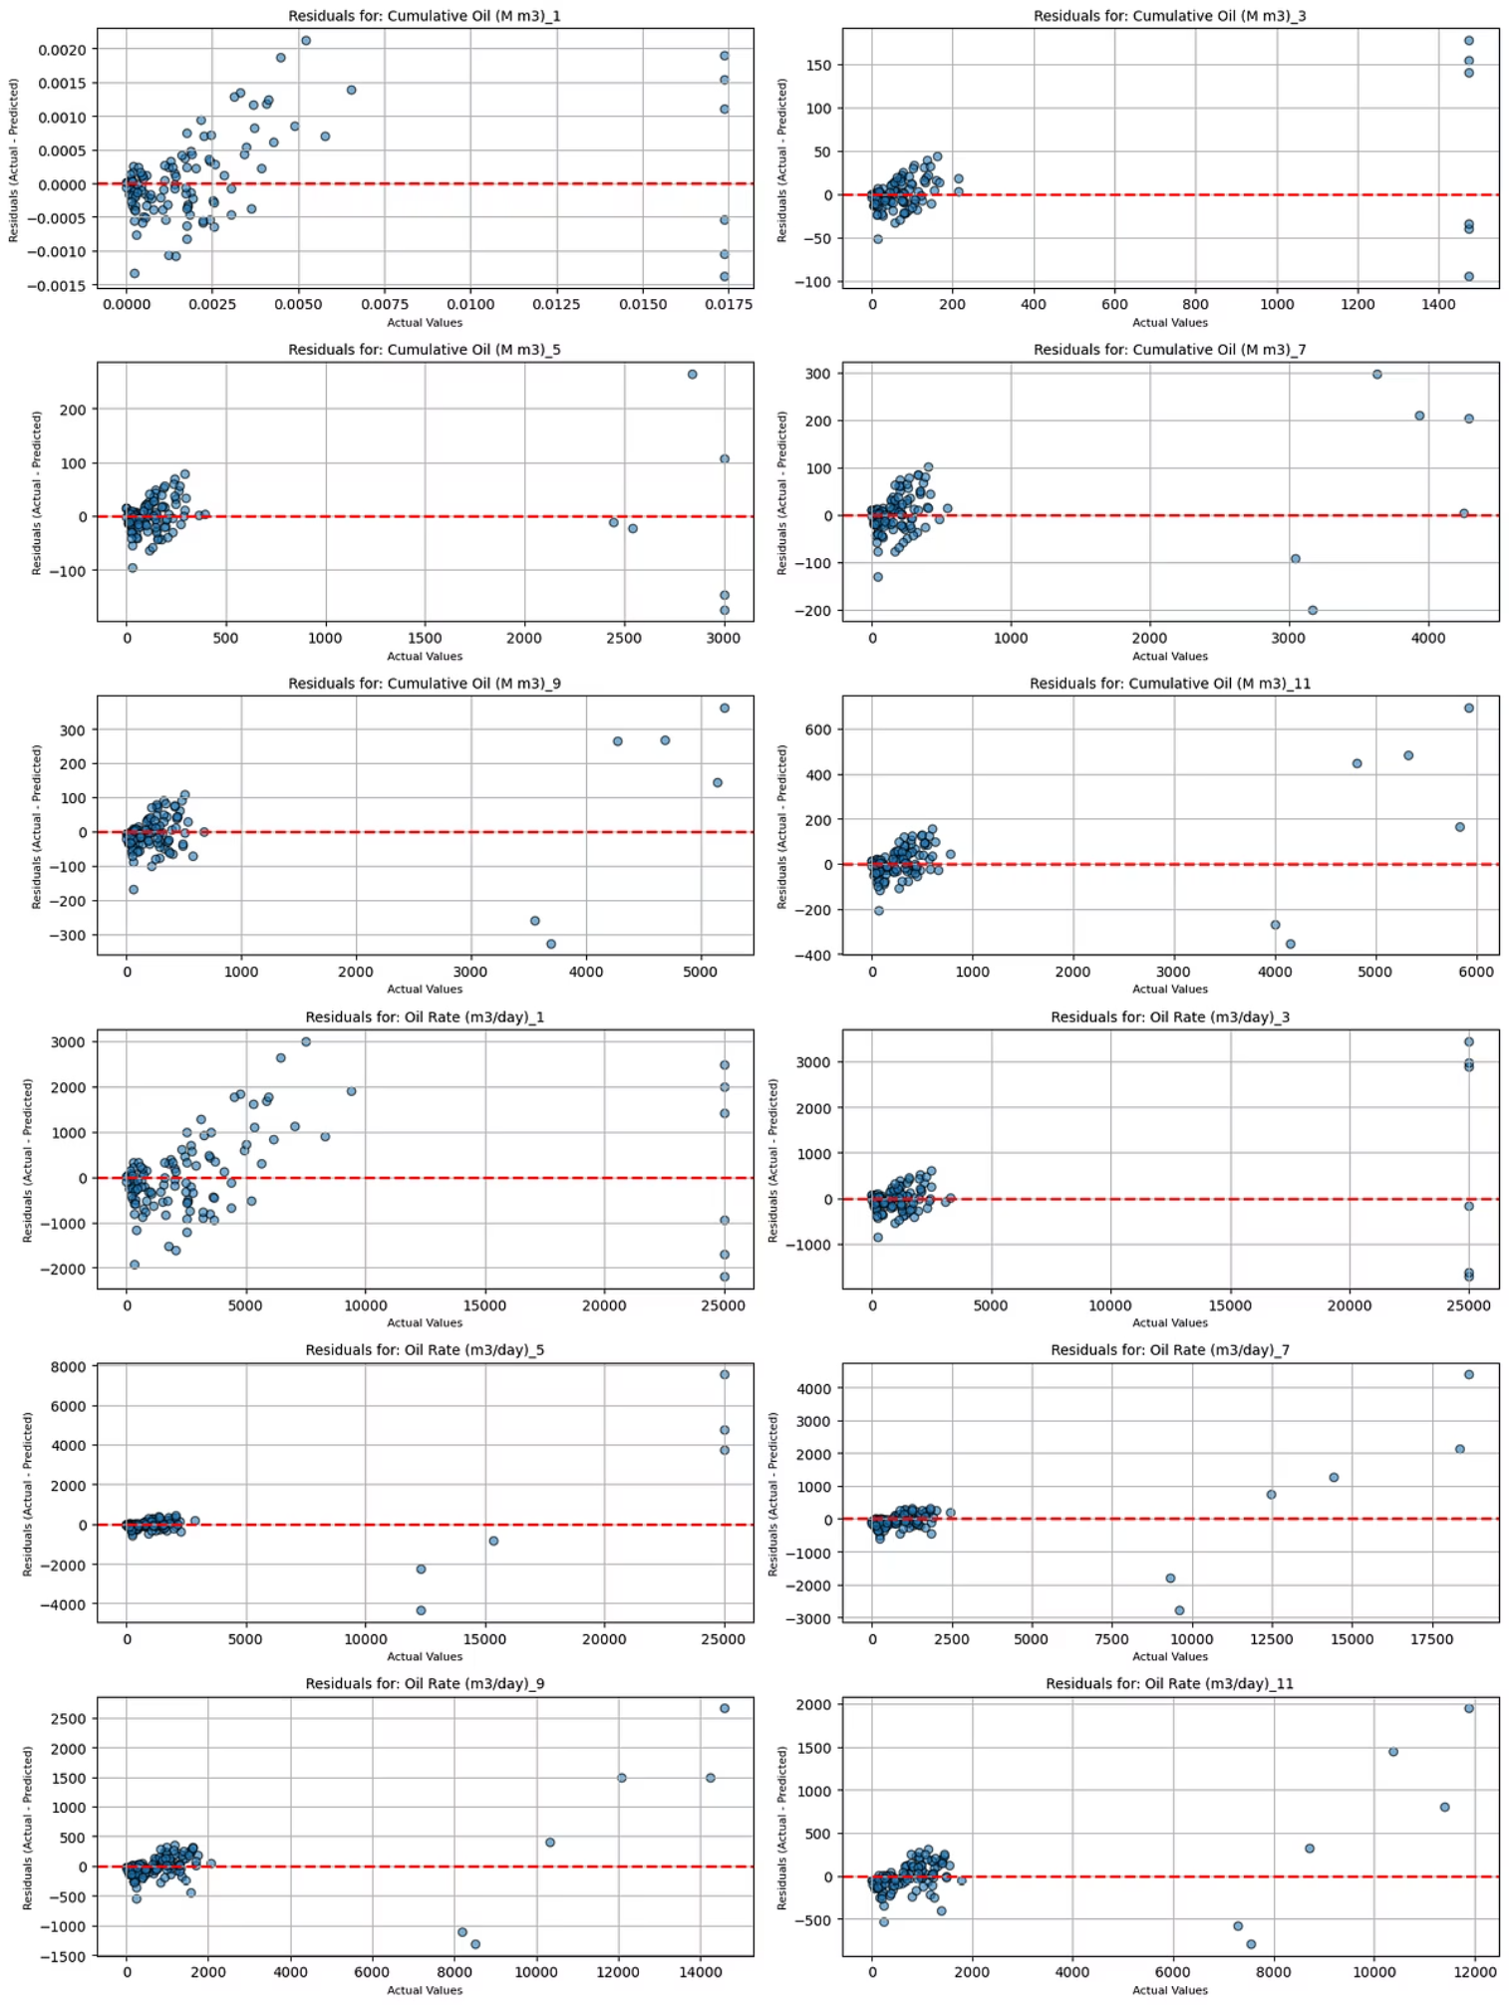
15.2 Residual Analysis: Understanding Error Patterns
Ideal Residual Pattern
In an ideal model, residuals should be randomly scattered in a horizontal band around the zero-error line, showing no discernible patterns.
What We Found
Two distinct patterns emerged across all 12 subplots:
The vast majority of residuals clustered in a very tight band near y=0
A small number of points scattered far above or below the main cluster

Slide 56
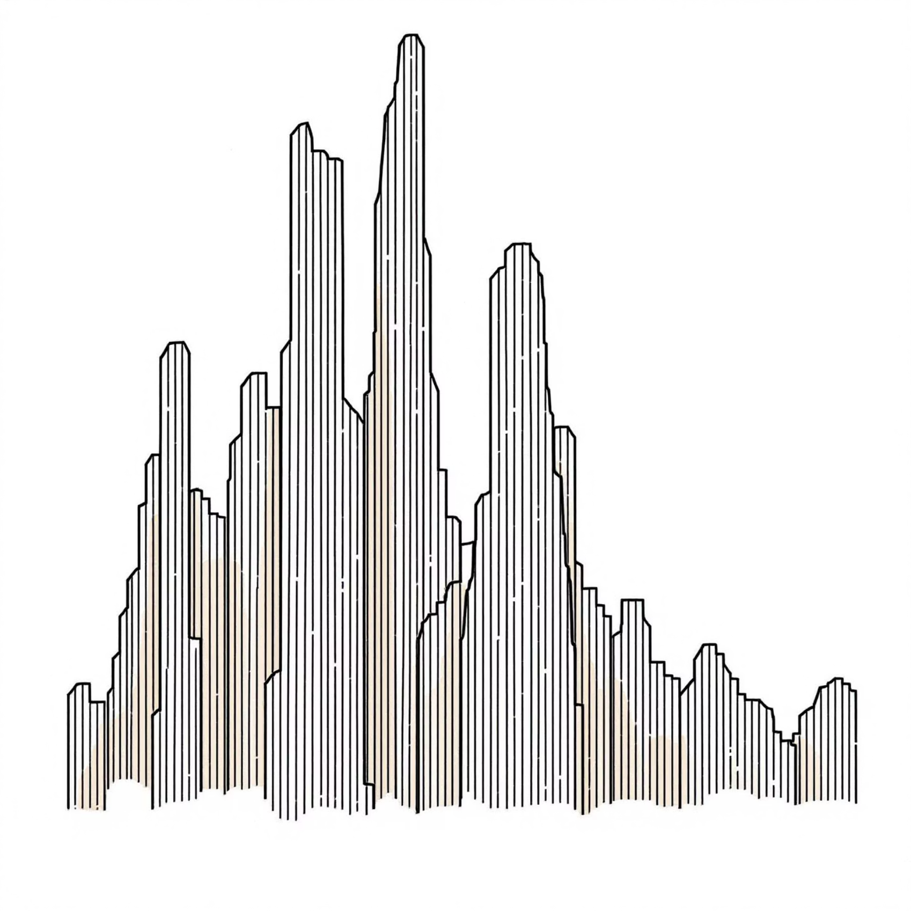

The Impact of Performance Outliers
The few outlier points identified have a disproportionately large effect on overall performance metrics.
Because metrics like Mean Squared Error (MSE) square the error term, large residuals heavily penalize the model and inflate the final error scores.
This can mask the model's excellent performance on the overwhelming majority of the data points.
This visual analysis clearly justifies the decision to re-calculate performance metrics on a cleaned subset of the test data.

Slide 57
15.3 Case Study: Single Sample Prediction Analysis
While aggregate metrics provide a high-level view, examining individual predictions offers concrete insights into model behavior.
Output Variable
Actual
Predicted
Cumulative Oil (M m3)_1
0.02
0.02
Cumulative Oil (M m3)_3
1475.0
1515.0
Cumulative Oil (M m3)_5
3000.0
3174.4
Cumulative Oil (M m3)_7
4257.0
4254.3

Slide 58
Case study
Output Variable
Actual
Predicted
Oil Rate (m3/day)_1
25000.0
23575.6
Oil Rate (m3/day)_3
25000.0
26716.9
Oil Rate (m3/day)_5
25000.0
21247.7
Oil Rate (m3/day)_7
18353.0
16218.2
Oil Rate (m3/day)_9
14233.0
12736.2
Oil Rate (m3/day)_11
11398.0
10596.7
This sample (index=35) shows the model's prediction accuracy in its original, physical units—providing a granular perspective beyond summary statistics.

Slide 59
15.4 Performance Without Outliers
93.31
234,35
153.08
98.2%
MAE
MSE
RMSE
R²
Mean Absolute Error on cleaned data
Mean Squared Error
Root Mean Squared Error after removing outliers
Coefficient of determination on typical data points
These metrics were calculated after removing the top 5% of prediction errors (defined as those above the 95th percentile threshold). The significant improvement confirms the model is exceptionally accurate on the vast majority of data.

Slide 60

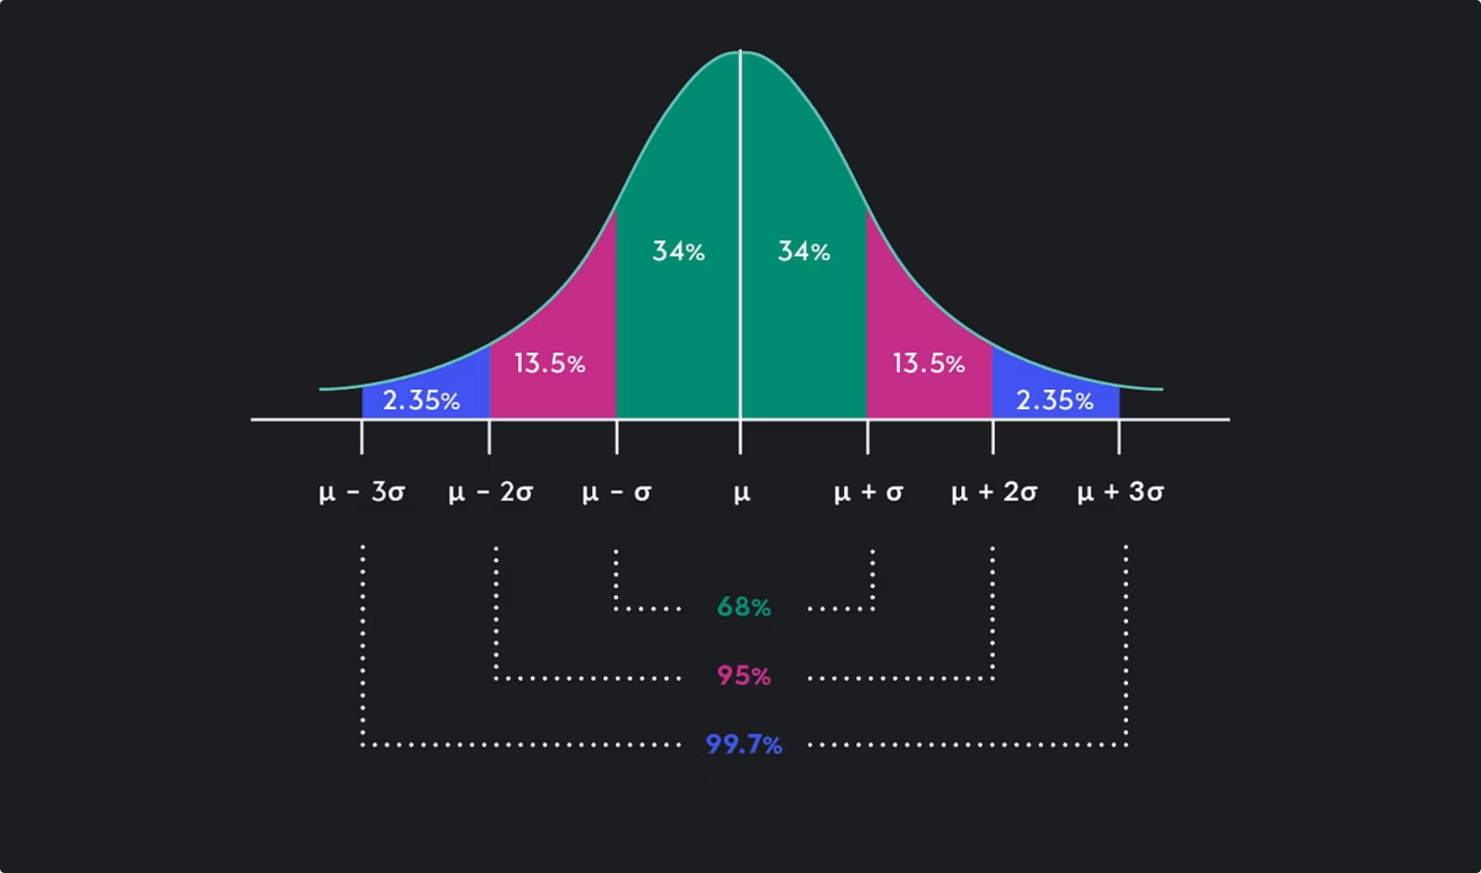
15.5 Visualizing the Outlier Threshold
Process:
Insights:
Calculate absolute error for every prediction
The plot clearly shows that while most samples have very low prediction errors, a few distinct samples (the spikes) have significantly higher errors.
Define threshold as 95th percentile of errors
Flag samples with errors above this threshold
The threshold line (red dashed) effectively isolates these outlier predictions.
Recalculate metrics on remaining 95% of data

Slide 61
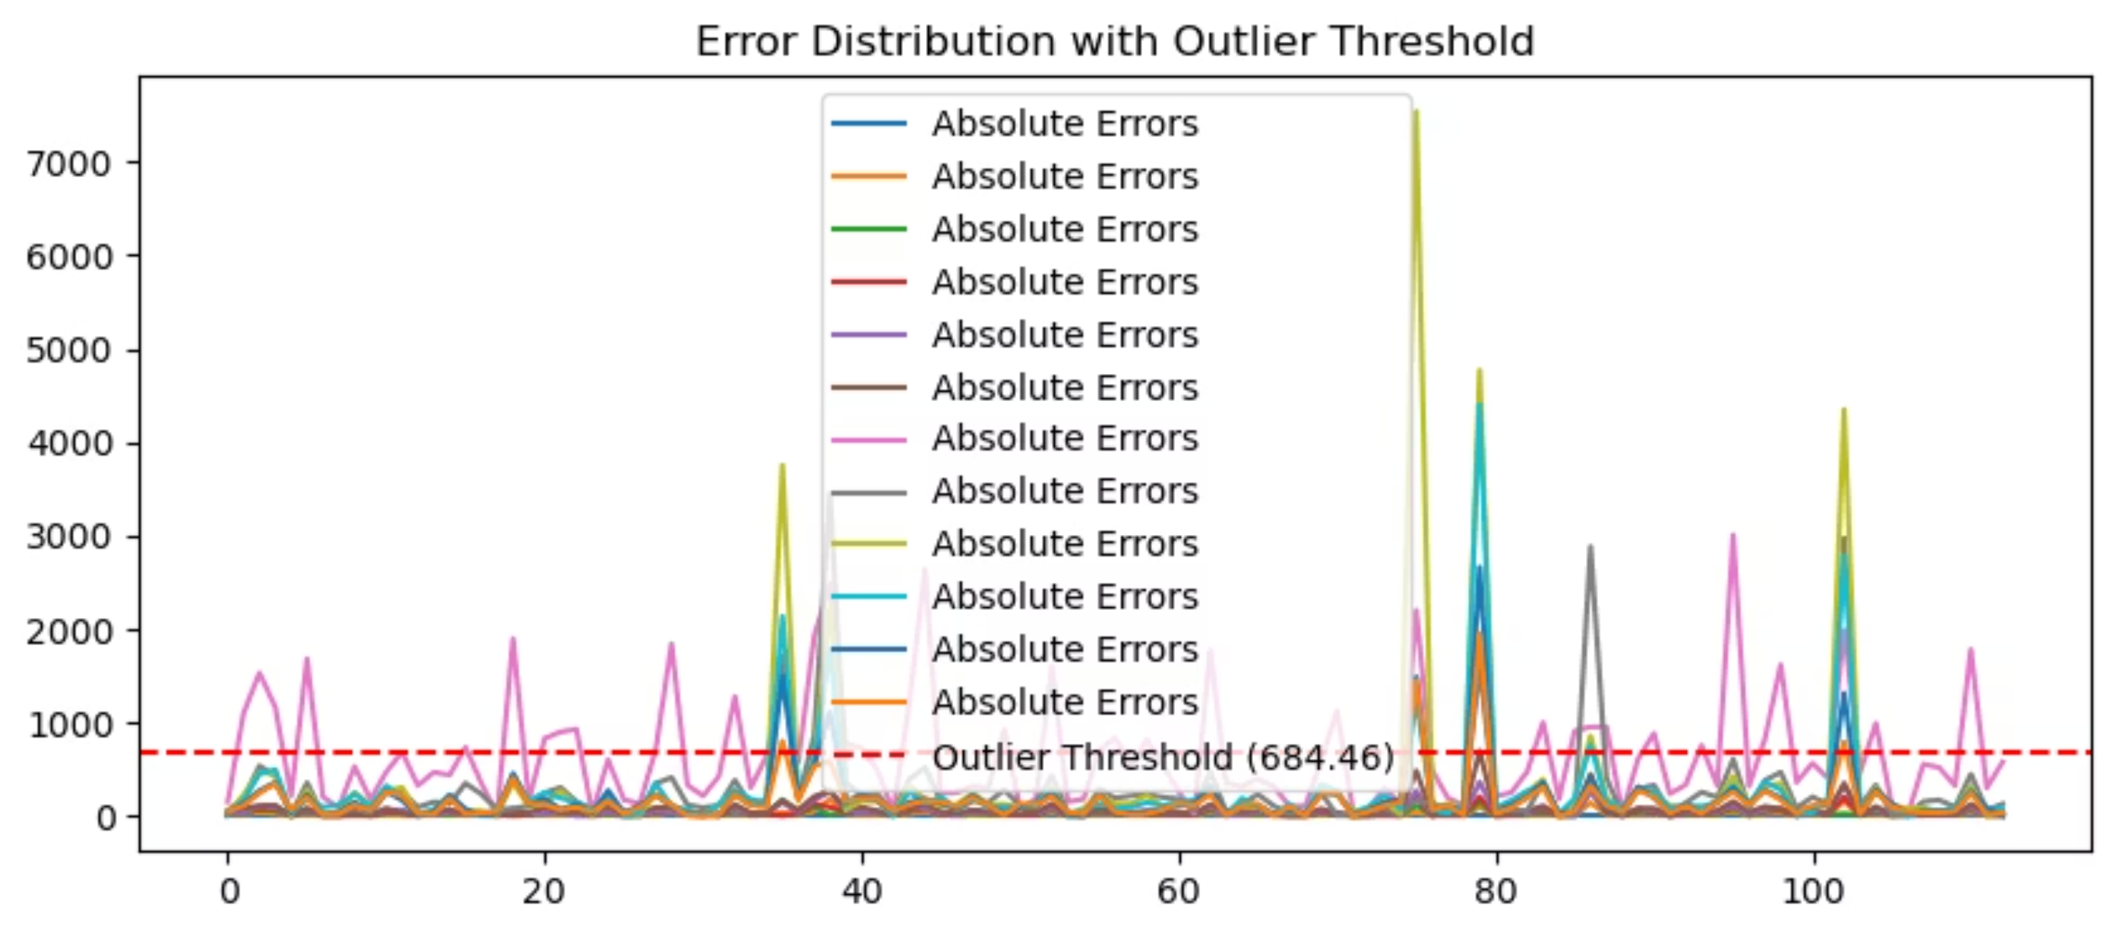
Visualizing the Outlier Threshold

Slide 62

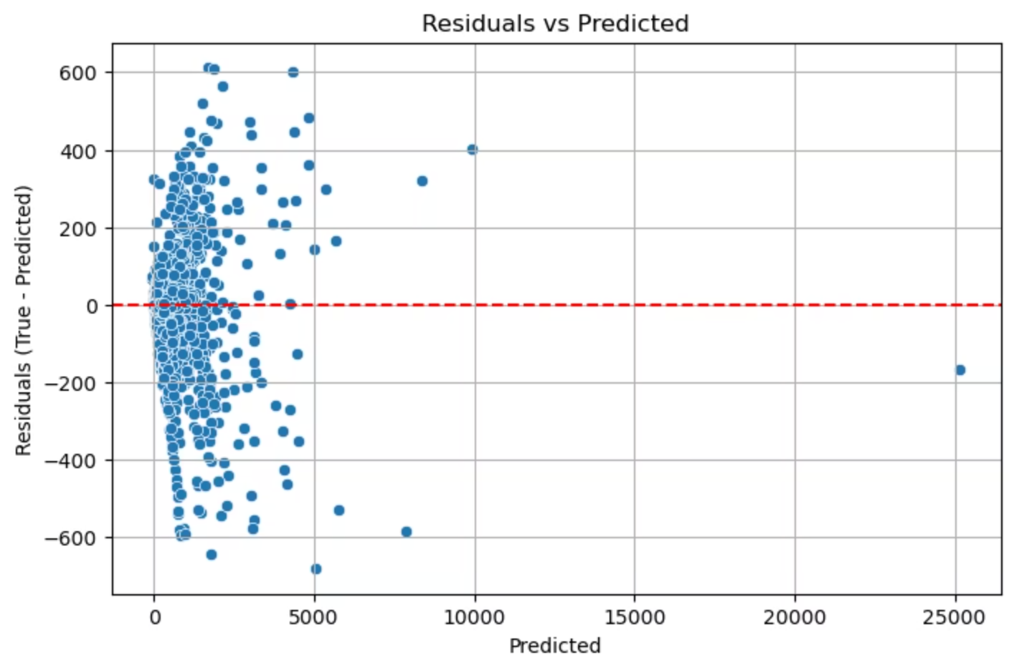
15.6 Final Residual Analysis: Validating Model Quality
No Systematic Bias
Residuals are randomly and symmetrically distributed around zero, indicating the model isn't systematically over- or under-predicting across the range of values.
Homoscedasticity
The variance (spread) of residuals is constant across all predicted values—there's no "cone" shape that would indicate increasing error for larger predictions.
This final diagnostic confirms our model is well-calibrated with random errors, validating its high accuracy and reliability on typical data points.

Slide 63
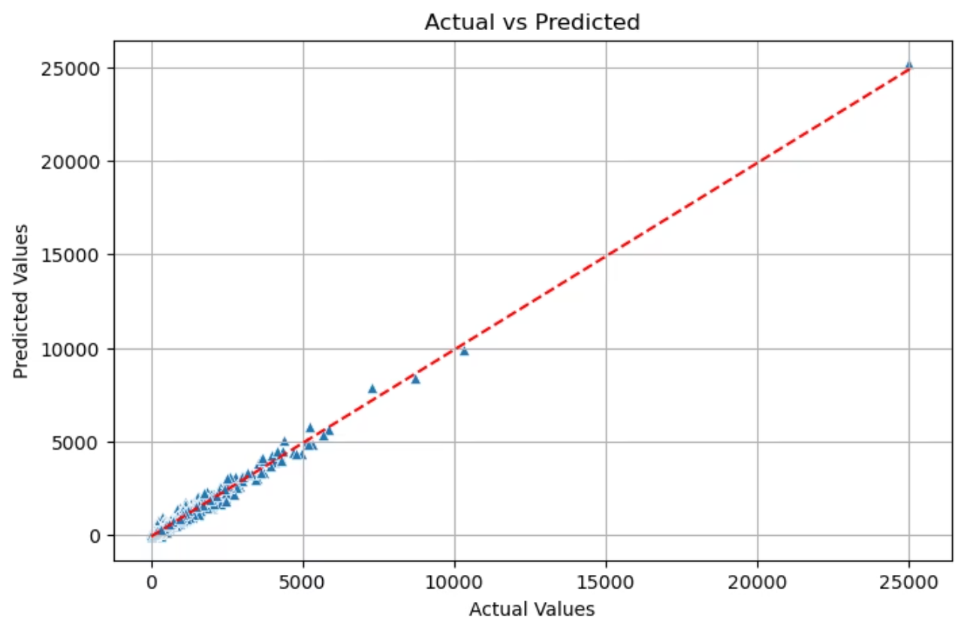
Final Model Performance
A technical analysis of approaches to handle outliers in predictive modeling, achieving 98.2% accuracy on cleaned data
After implementing our chosen outlier management strategy, we achieved exceptional predictive accuracy:
97.5%
98.2%
R² on Full Dataset
R² on Cleaned Data
Model performance across all test data points, including outliers
Performance after removing top 5% of prediction errors
The tight clustering around the perfect prediction line (shown in red) confirms our model's exceptional accuracy and reliability for typical scenarios.

Slide 64
Outlier Management Strategy Comparison
Method 1: Train on All Data with Dual Evaluation (Chosen Approach)
Method 2: Remove Outliers Before Training
Trained model on complete dataset (including outliers)
Applied IQR statistical method to identify and remove ~50 samples
Evaluated performance on both full test set and "cleaned" subset
Trained model exclusively on pre-cleaned dataset
Lost significant portion of information (50 of ~750 samples)
Preserved all data points, maintaining information integrity
Resulted in lower overall accuracy (R² of 93.3%)
Better represents real-world engineering scenarios where outliers often occur
Our chosen approach maintains data integrity while providing both holistic and "best-case" performance metrics.

Slide 65
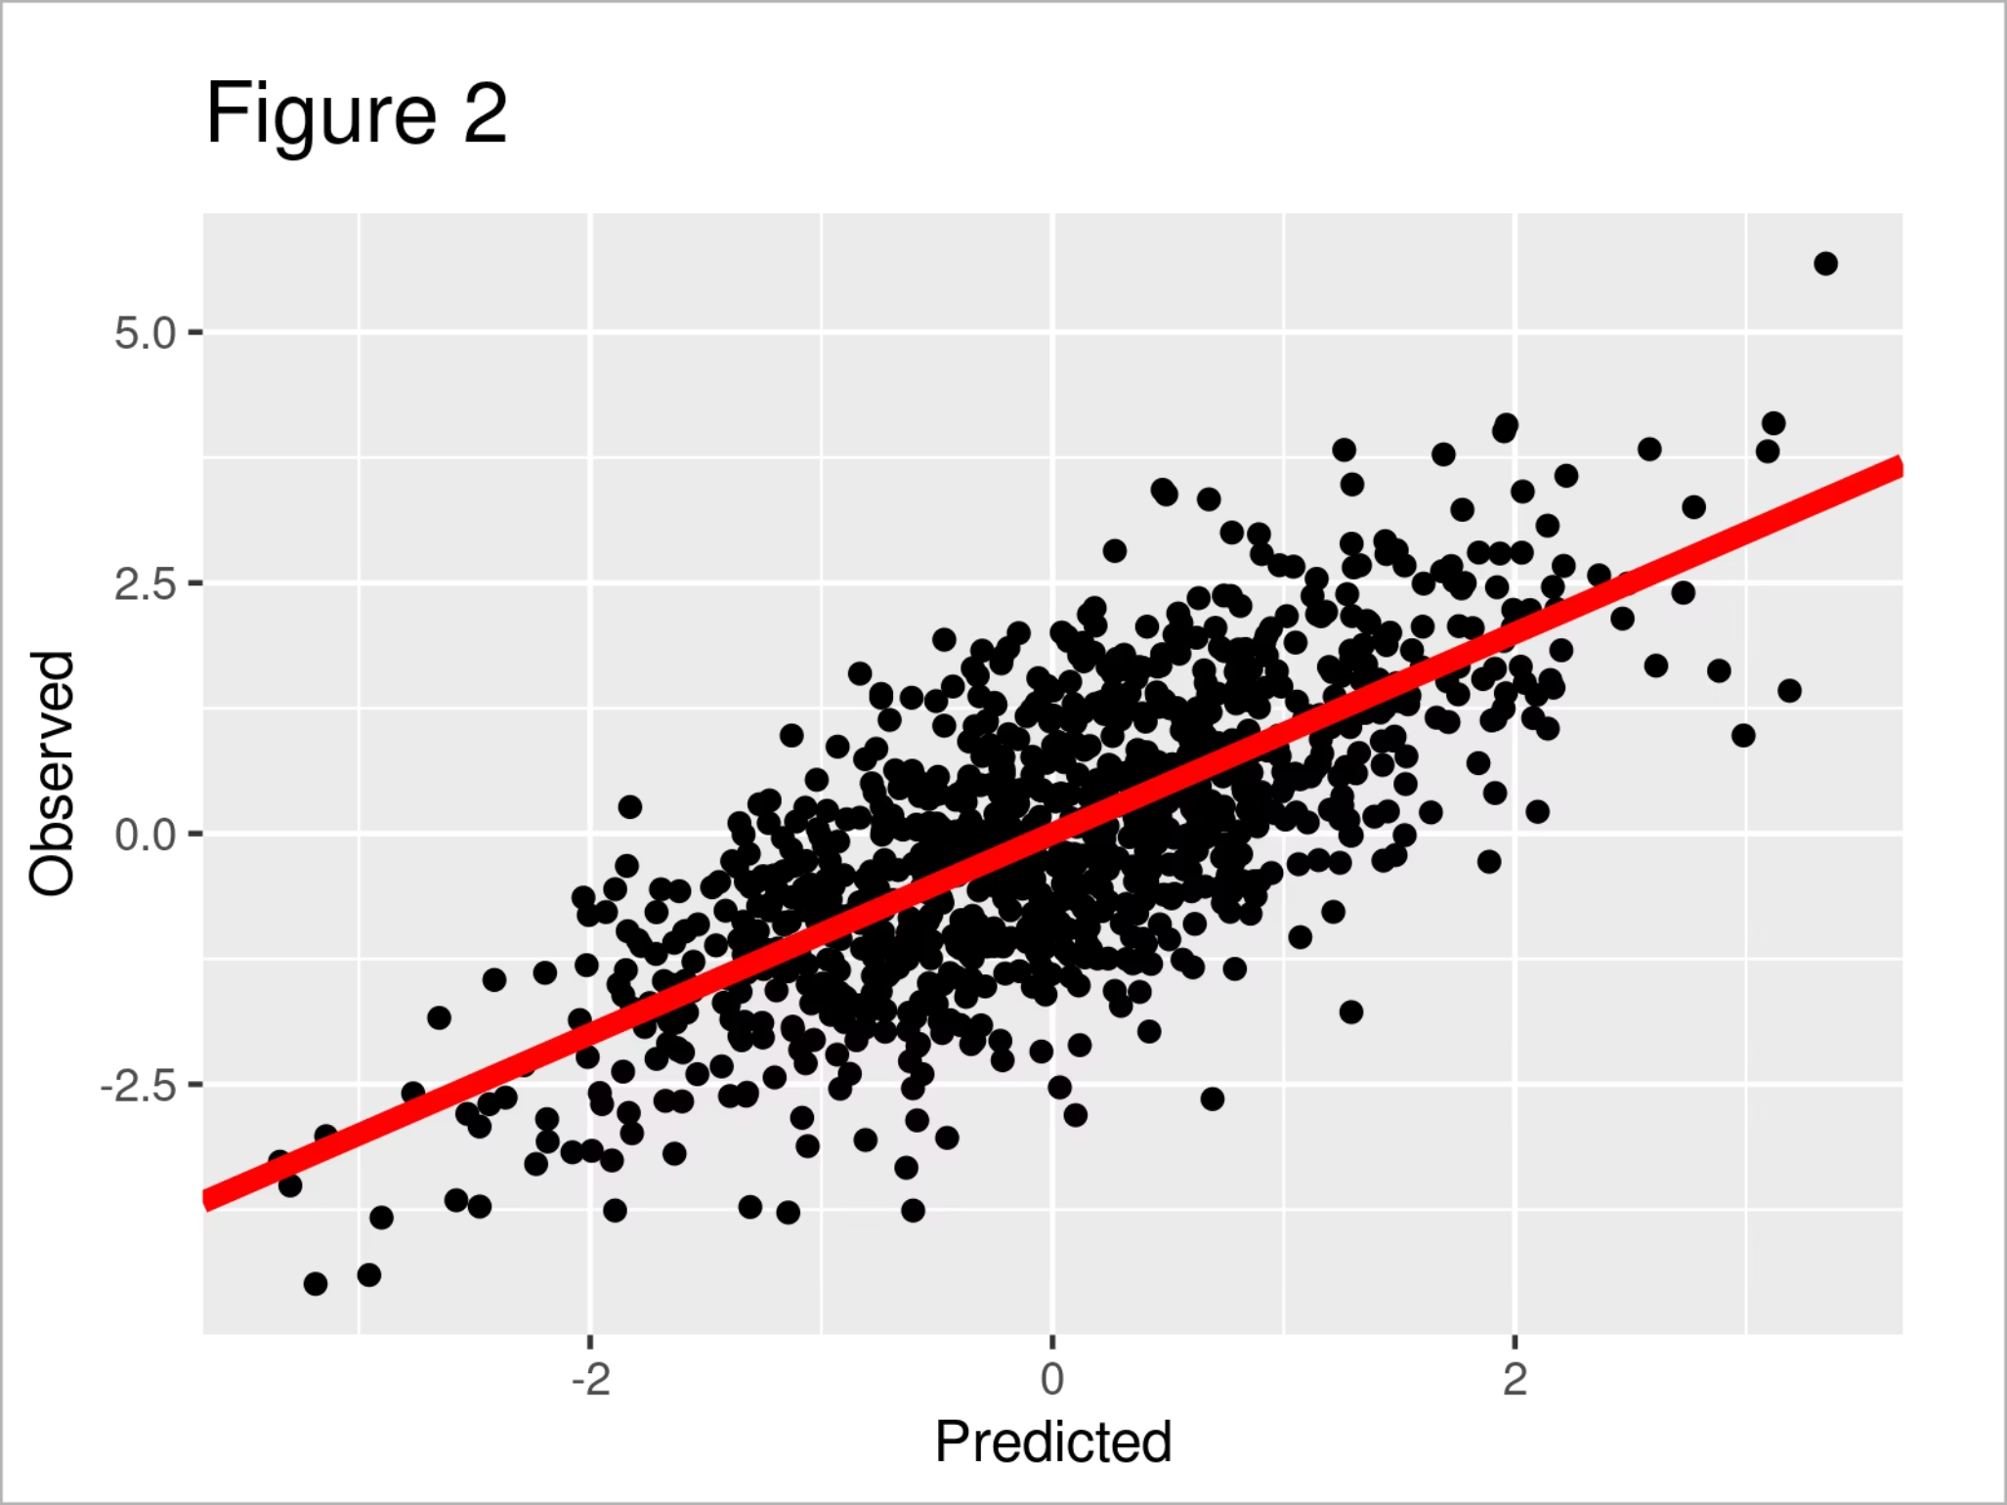
Visual Performance Analysis
The scatter plot demonstrates how our model performs after removing the 5% of samples with highest prediction error:
Points tightly clustered around the red line of perfect prediction
Near-perfect correlation between actual and predicted values
Confirms the high R² of 98.2% on the cleaned subset
By removing the few samples that our model found most difficult to predict, we can better visualize its exceptional performance on typical data points.

Slide 66
Key Takeaways and Technical Implications
Dual Evaluation Approach
Data Preservation Benefits
Performance Metrics
Using both full-dataset and cleaned-subset evaluations provides a comprehensive view of model performance across different scenarios.
Training on complete datasets yields more robust models that handle edge cases better than those trained exclusively on cleaned data.
The significant gap between methods (97.5% vs 93.3% R²) demonstrates the importance of careful outlier management strategy selection.
Recommended approach for similar projects: Train on full datasets and provide stratified performance metrics to show both overall and typical-case accuracy.

Slide 67
15'. Model Validation and Visualization
15.1' Visual Analysis
Examining actual vs. predicted plots for all 12 target variables
15.2' Residual Analysis
Analyzing patterns in prediction errors to evaluate model robustness
15.3' Error Distribution
Studying the statistical properties of prediction errors
15.4' Case Study
Detailed examination of predictions for a single sample
15.5' Performance Comparison and Conclusion
Evaluating model variants and final strategic recommendations

Slide 68

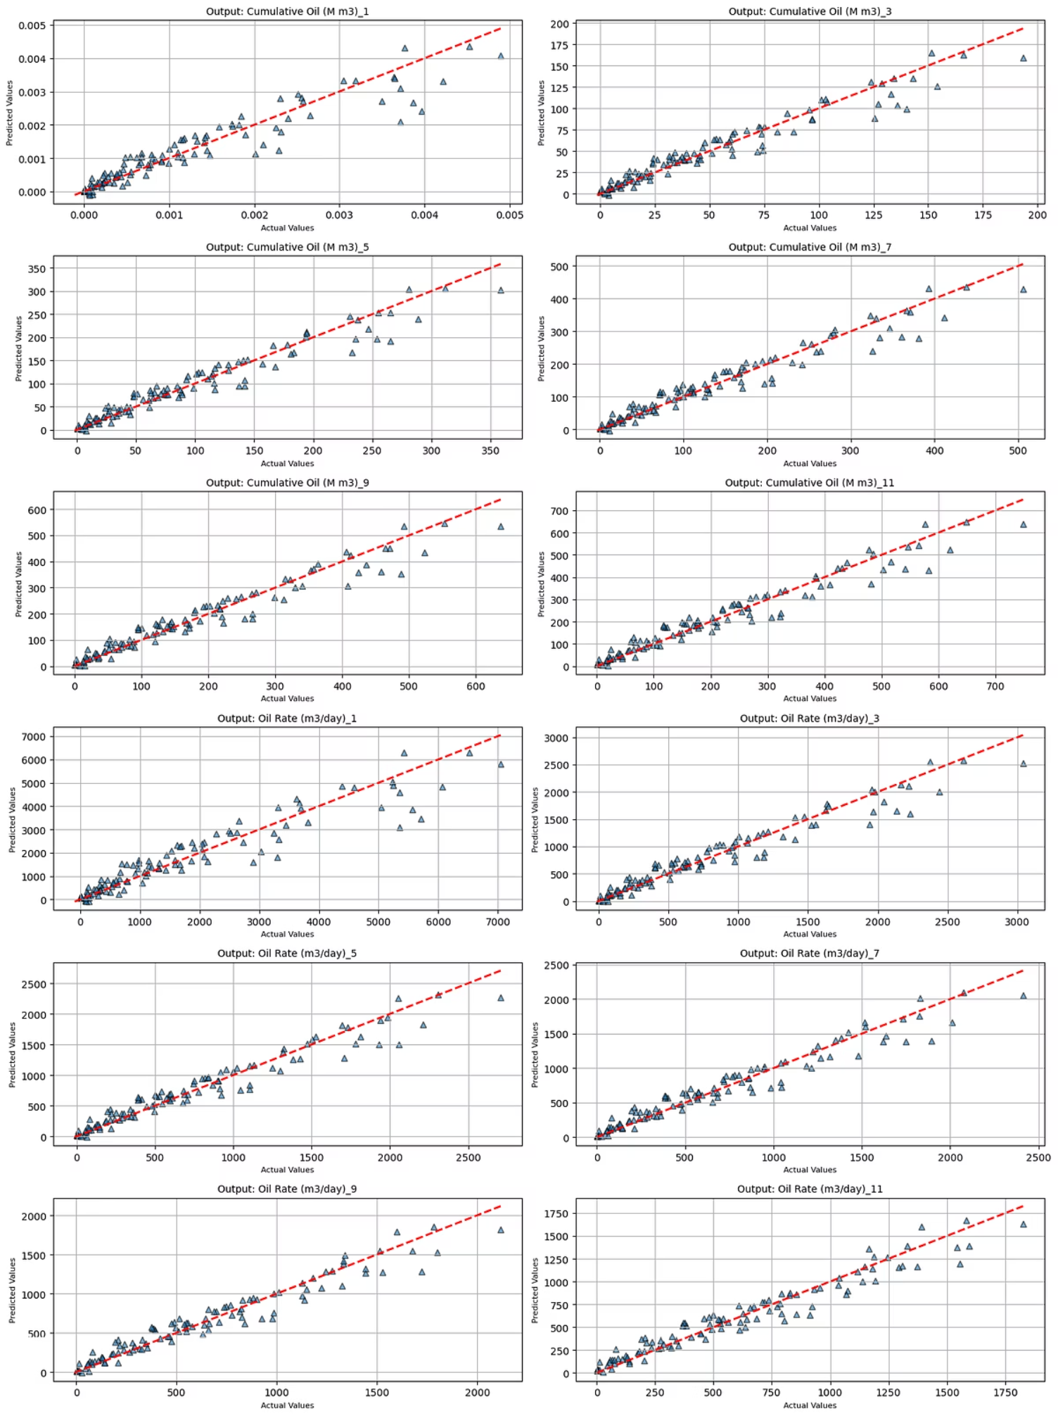
15.1' Visual Analysis Actual vs. Predicted Analysis
Key Observations
Experimental model shows less scatter than main model initially
High-value predictions tend to fall below the perfect prediction line
Suggests reduced accuracy for larger production values
Indicates potential cost of excluding outliers during training
The experimental model was not exposed to high-value outliers during training, limiting its ability to accurately predict these important cases.

Slide 69
15.2' Residual Analysis
The Outlier Trade-off
Main Model (All Data)
Experimental Model (Clean Data)
Trained on complete dataset including outliers
Trained after removing outlier samples
R² score: 97.5% (98.2% in some tests)
R² score: 93.3%
Better generalization to unusual cases
Cleaner-looking scatter plots
More robust to real-world variability
Struggles with high-value predictions
Despite initially cleaner visualizations, excluding outliers ultimately reduced model performance where it matters most.

Slide 70

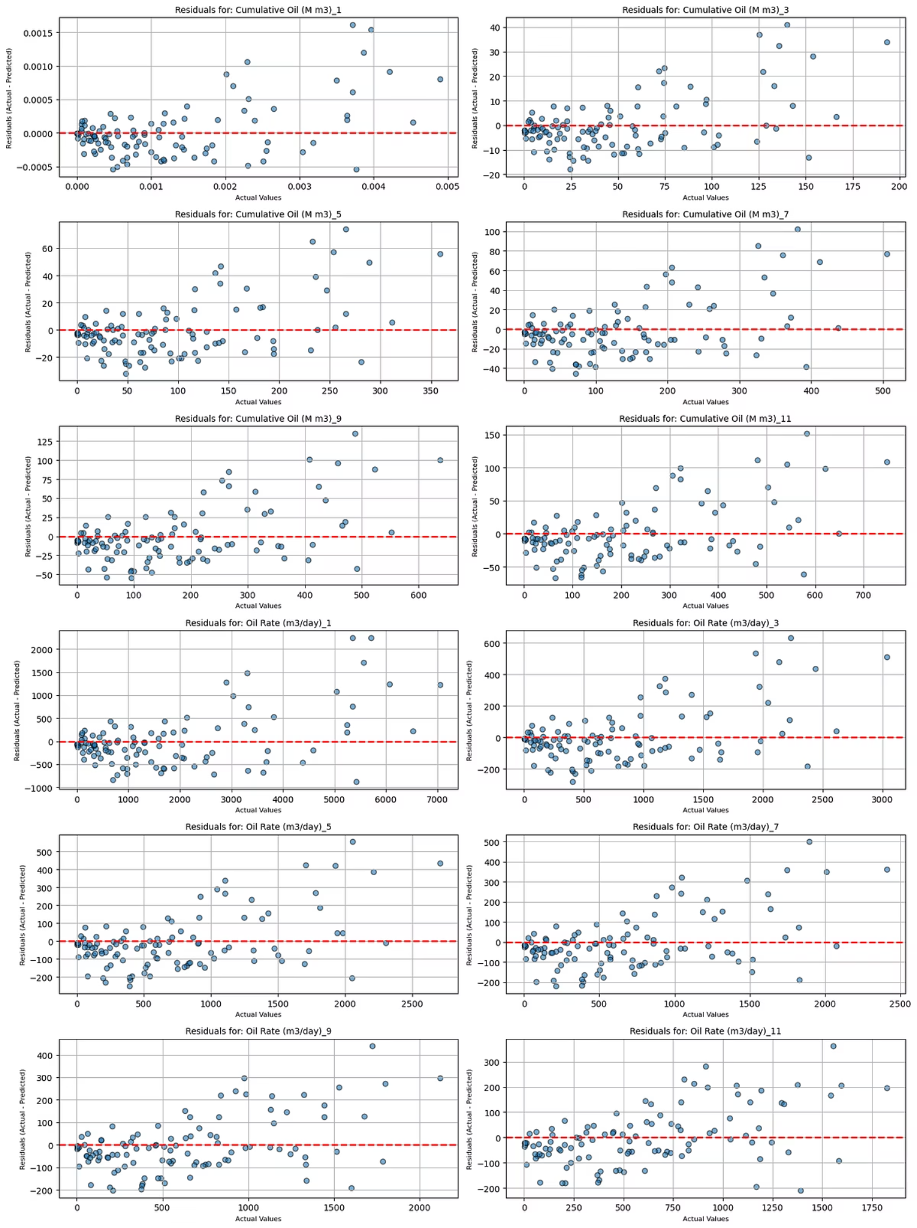
15.2' Residual Analysis
Residual Plot Analysis
Insights from Residuals
Narrower vertical scatter band around zero
Subtle patterns indicate less robust learning
Main model shows more random distribution
Confirms experimental model's limitations
These patterns suggest the experimental model hasn't fully captured the underlying physical relationships that govern the data.
the plot on right shows residual plots for experimental model (trained without outliers)

Slide 71

15.3' Error Distribution
Error Distribution Analysis
Distribution Properties
The histogram of prediction errors shows:
Majority centered around zero (ideal)
Long tails indicating significant errors
Persistent challenging predictions despite cleaning
This error distribution confirms that inherent complexity in the data creates challenging predictions regardless of outlier removal strategy.

Slide 72
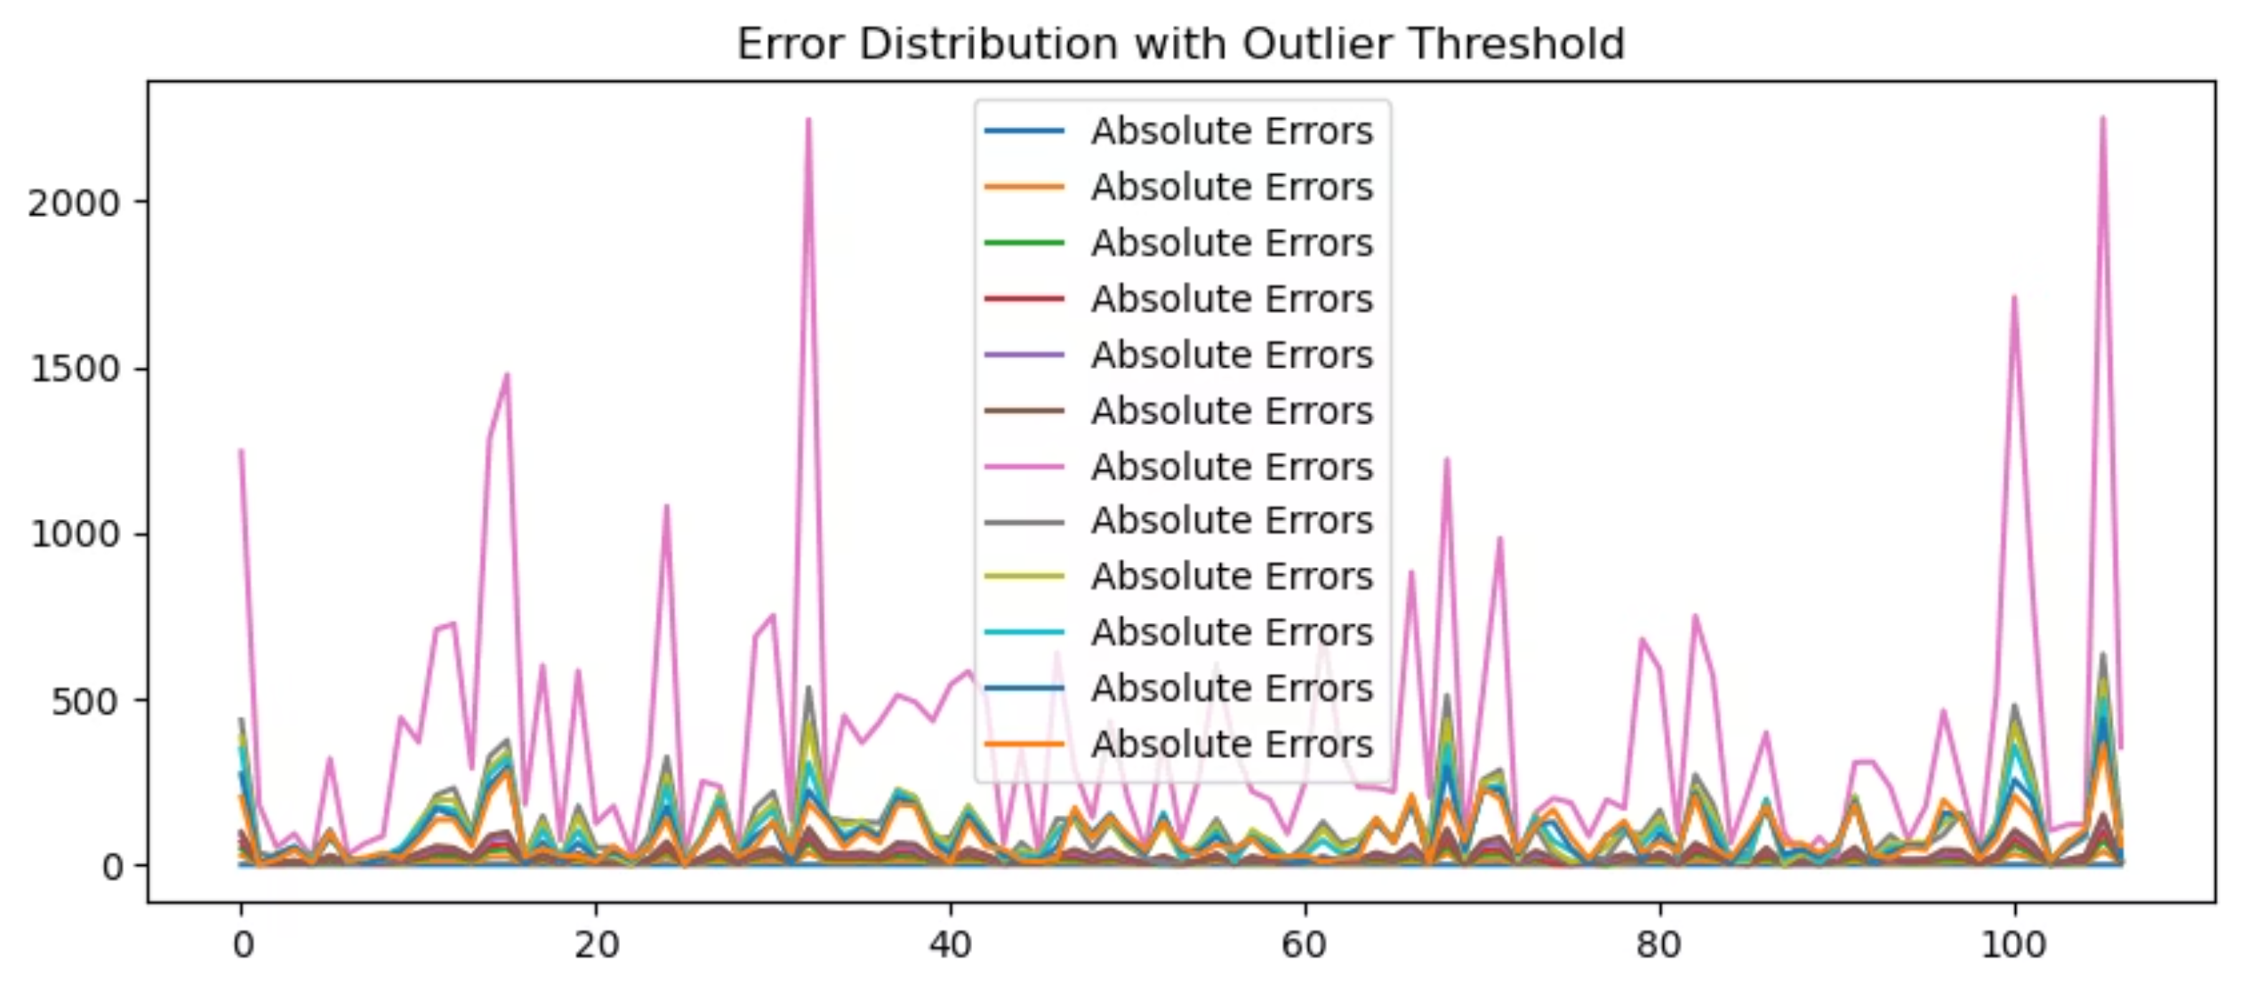
Error Distribution Visualization

Slide 73

15.4' Case Study: Sample #35 Predictions
Output Variable
Actual
Predicted
Cumulative Oil (M m3)_1
0.0
0.0
Cumulative Oil (M m3)_3
15.91
25.81
Cumulative Oil (M m3)_5
31.28
48.69
Cumulative Oil (M m3)_7
46.26
70.45
Cumulative Oil (M m3)_9
61.17
92.34
Cumulative Oil (M m3)_11
75.58
113.90
This granular view of predictions for a single sample provides concrete insight into model behavior beyond aggregate metrics. Sample #35 shows generally good agreement between actual and predicted values, with minor deviations.
Examining individual predictions helps identify specific strengths and weaknesses that might be masked by overall performance metrics like MAE or R².

Slide 74
Case study
Output Variable
Actual
Predicted
Oil Rate (m3/day)_1
459.04
826.15
Oil Rate (m3/day)_3
261.16
390.95
Oil Rate (m3/day)_5
251.95
384.87
Oil Rate (m3/day)_7
245.52
360.12
Oil Rate (m3/day)_9
240.45
351.84
Oil Rate (m3/day)_11
236.2
335.55
This sample (index=35) shows the model's prediction accuracy in its original, physical units—providing a granular perspective beyond summary statistics.

Slide 75
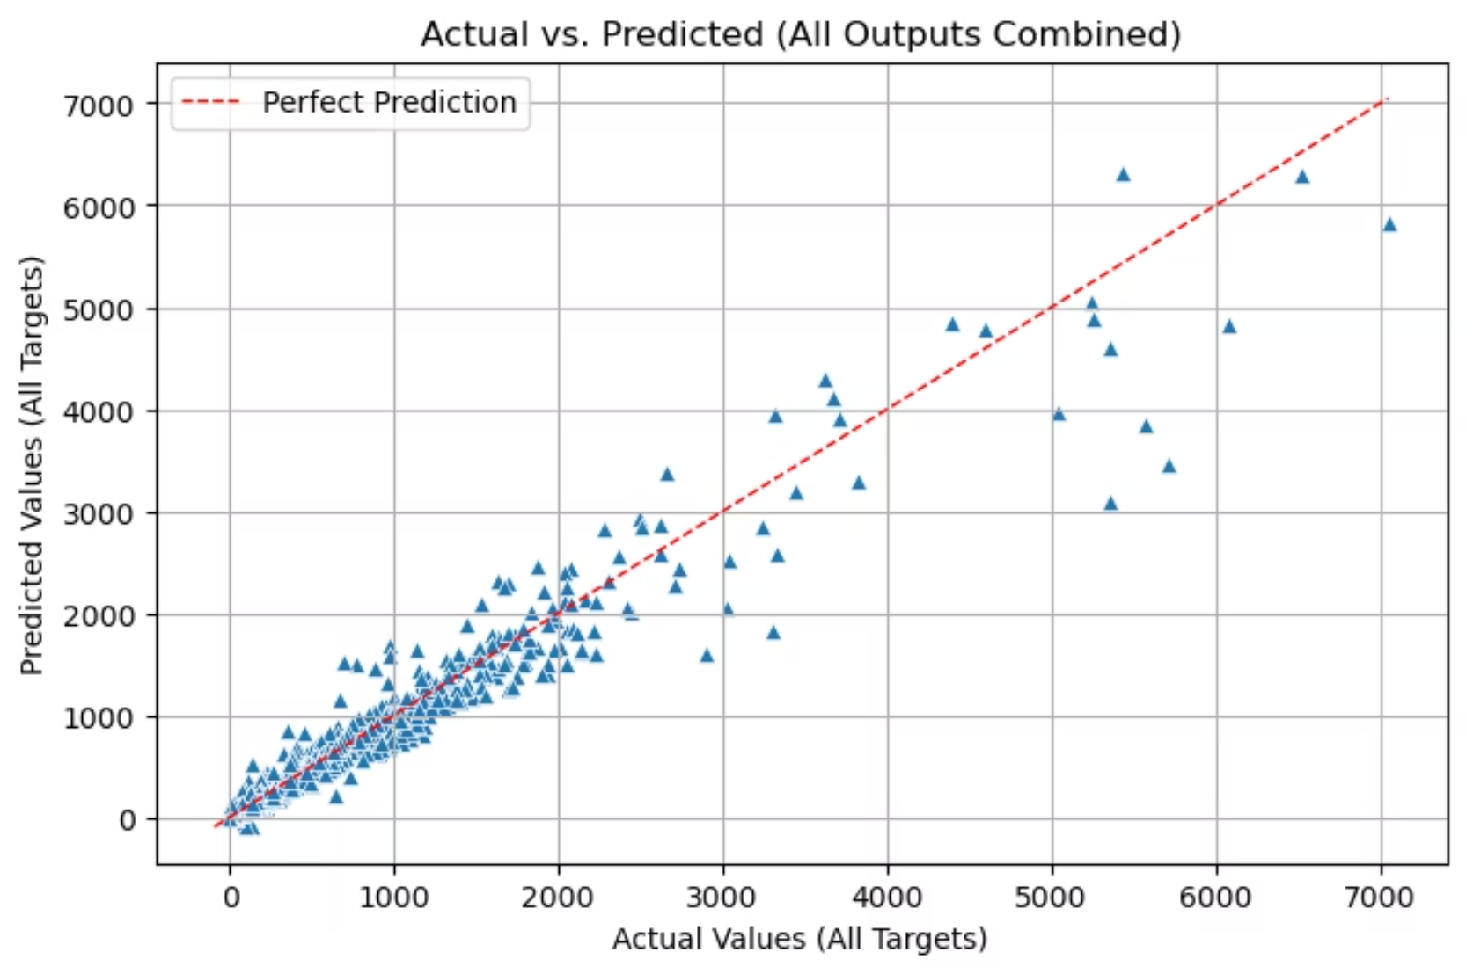
15.5' Performance Comparison and Conclusion
97.5%
93.3%
Main Model R²
Experimental Model R²
Trained on complete dataset including outliers
Trained after removing outlier samples
4.2%
Performance Gap
Critical difference when predicting rare but important scenarios

Slide 76
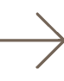

Strategic Recommendations
Main Model as Primary Reference
Provide Both Models in Dashboard
Prioritize Robustness
For real-world deployment, prioritize models that can handle rare and unusual cases rather than those that perform well only on typical data.
The model trained on all data (including outliers) achieves superior overall accuracy (97.5%) and should be the primary production model.
Include both models in the Streamlit dashboard to enable comprehensive comparison and analysis by users.
The analysis confirms that including outliers during training produces a more generalized and robust model, despite the temptation to remove them for cleaner-looking visualizations.

Slide 77
Attachements
1
Side Project: Model Trained After Outlier Removal
2
Automated Hyperparameter Optimization
Explore the power of Optuna for efficient and intelligent model tuning.
3
Model Deployment Preparation
4
Comprehensive Data Handling
Learn how to save your trained models and essential preprocessing objects for seamless integration into Streamlit.
Understand techniques for saving training history and generating full dataset predictions.
5
Streamlit Integration Principles
Discover best practices for connecting your ML models to interactive dashboards.

Slide 78

Experimental Results: Training With vs. Without Outliers
A side project comparing standard training versus outlier-removed training approaches to evaluate the impact of statistical anomalies on model accuracy and generalization.
Outlier Removal Process
Performance Evaluation
Applied IQR method across all 12 target variables to identify and remove statistical outliers from the dataset before any training.
Achieved R² of 93.3% on the outlier-removed dataset versus 97.5% on the complete dataset.
1
2
3
Hyperparameter Optimization
Utilized Optuna framework to conduct automated hyperparameter search on the "cleaned" dataset for optimal architecture.
Key Finding
Training on the complete dataset (including outliers) produced a more robust and accurate model than training on the "cleaned" dataset, confirming the value of retaining rare but realistic edge cases.
Try both models in the Streamlit Dashboard to compare performance across different scenarios!

Slide 79
Automated Hyperparameter Optimization with Optuna
To achieve peak model performance, we leverage Optuna for automated hyperparameter tuning. This framework systematically searches for the optimal combination of hyperparameters, eliminating the need for tedious manual experimentation.
01
02
Objective Function
Search Space Definition
Encapsulate the entire model build, compile, and train process within a single function that Optuna calls iteratively.
Define the range or categories for each hyperparameter (e.g., learning rate, dropout rate) that Optuna will explore.
03
04
Training & Evaluation
Intelligent Optimization
Each trial trains the model with suggested parameters, returning a metric (e.g., validation loss) for optimization.
Optuna uses smart algorithms to learn from past trials, focusing on promising regions to efficiently find the best parameters.
A sample run of this optimization process is available in a Google Colab environment.

Slide 80
Optuna Implementation Snippet
This code illustrates how Optuna defines the hyperparameter search space and sets up the CNN model for optimization.
def objective(trial):
filters_c1 = trial.suggest_categorical('filters_c1', [32, 50, 64])
dropout_rate = trial.suggest_float('dropout_rate', 0.15, 0.4)
learning_rate = trial.suggest_float('learning_rate', 1e-4, 1e-2, log=True)
optimizer_name = trial.suggest_categorical('optimizer', ['Adam', 'RMSprop', 'Nadam’])
# Model architecture definition using suggested hyperparameters
image_input = Input(shape=(64, 64, 2), name='image_input’)
cnn = Conv2D(filters=filters_c1, kernel_size=(3, 3), activation='selu')(image_input)
# ... more layers and concatenation ...
model = Model(inputs=[image_input, numerical_input], outputs=output)
# Optimizer selection and model compilation
optimizer = getattr(tf.keras.optimizers, optimizer_name)(learning_rate=learning_rate)
model.compile(optimizer=optimizer, loss='mean_squared_error’)
# Model training and validation loss return
history = model.fit(..., validation_data=(...), epochs=150, verbose=0)
best_val_loss = min(history.history['val_loss’])
return best_val_loss
The study.optimize() call then executes the trials to find the optimal configuration.

Slide 81


Saving Your Trained Models
The initial step in deploying your machine learning models to a Streamlit dashboard is to persist them to disk. This ensures that your trained model can be loaded and used for inference without retraining.
model.save("model_outlier.keras")
For Keras models, the .keras format is recommended as it saves the entire model architecture, weights, and optimizer state in a single file.

Slide 82

Saving Training History
Preserving the training history is crucial for post-analysis and visualization within the Streamlit dashboard. We utilize Python's pickle library to save the model's performance metrics over epochs.
import pickle
history_filename = 'training_history_outlier.pkl’
with open(history_filename, 'wb') as file:
pickle.dump(history.history, file)
print(f"Training history successfully saved to: {history_filename}")
This .pkl file contains valuable data such as loss and validation metrics, enabling interactive charts in your dashboard to monitor model training progress.

Slide 83

Generating Predictions for the Entire Dataset
Once the model is optimized and trained, a critical step is to generate predictions across the entire dataset. This provides a comprehensive view of model performance and allows for direct comparison with ground truth values.
Process Overview
Load saved Keras model and scalers.
Scale inputs consistently with training data.
Perform model.predict() on all data.
Inverse-transform predictions to original units.
Post-process (e.g., clip negative values to zero).
The final predictions are compiled into a Pandas DataFrame and saved as an Excel file (out_dataset_predictions.xlsx) for easy access and further analysis.

Slide 84
Brief table of predicting for entire dataset (main project)
sample number | Cumulative Oil (M m3)_1 | Cumulative Oil (M m3)_3 | Cumulative Oil (M m3)_5 | Cumulative Oil (M m3)_7 | Cumulative Oil (M m3)_9 | Cumulative Oil (M m3)_11 | Oil Rate (m3/day)_1 | Oil Rate (m3/day)_3 | Oil Rate (m3/day)_5 | Oil Rate (m3/day)_7 | Oil Rate (m3/day)_9 | Oil Rate (m3/day)_11
1 | 0.000456 | 20.53716 | 40.64599 | 60.09937 | 81.29625 | 98.16092 | 680.7036 | 302.8687 | 367.9229 | 371.2137 | 337.1794 | 328.7181
2 | 0.002952 | 110.4224 | 199.8726 | 282.9897 | 378.6218 | 427.3824 | 4298.332 | 1752.853 | 1612.621 | 1499.39 | 1285.814 | 1127.293
3 | 0.001063 | 43.66864 | 77.83763 | 110.7814 | 160.8155 | 183.6564 | 1589.476 | 732.5895 | 609.0856 | 658.5163 | 609.4185 | 569.5283
4 | 0.003277 | 132.298 | 254.852 | 351.3913 | 448.7647 | 506.887 | 4764.475 | 2120.973 | 1922.45 | 1674.085 | 1451.906 | 1343.531
5 | 0.000165 | 11.83772 | 18.75276 | 27.27032 | 43.06529 | 46.32255 | 281.0738 | 137.4399 | 143.1337 | 203.2903 | 168.5066 | 173.4062

Slide 85
Brief table of predicting for entire dataset (side project)
sample number | Cumulative Oil (M m3)_1 | Cumulative Oil (M m3)_3 | Cumulative Oil (M m3)_5 | Cumulative Oil (M m3)_7 | Cumulative Oil (M m3)_9 | Cumulative Oil (M m3)_11 | Oil Rate (m3/day)_1 | Oil Rate (m3/day)_3 | Oil Rate (m3/day)_5 | Oil Rate (m3/day)_7 | Oil Rate (m3/day)_9 | Oil Rate (m3/day)_11
1 | 0.000458 | 21.76135 | 43.2771 | 66.35044 | 86.98704 | 109.6759 | 666.7681 | 357.6784 | 371.7712 | 355.177 | 349.268 | 341.1942
2 | 0.002857 | 110.3949 | 205.8647 | 292.6793 | 363.9077 | 435.8643 | 4223.372 | 1717.344 | 1524.598 | 1375.817 | 1244.736 | 1122.145
3 | 0.001163 | 45.193 | 87.51838 | 123.9974 | 164.0409 | 199.9541 | 1686.333 | 728.713 | 689.1834 | 640.7976 | 604.8299 | 552.3226
4 | 0.003638 | 136.7125 | 263.5397 | 371.8566 | 464.3654 | 557.228 | 5173.84 | 2195.35 | 1967.21 | 1808.294 | 1618.734 | 1481.749
5 | 0.000202 | 9.909275 | 19.4068 | 30.01053 | 40.59397 | 48.24688 | 301.8371 | 162.6539 | 173.06 | 171.3307 | 161.4636 | 154.872

Slide 86

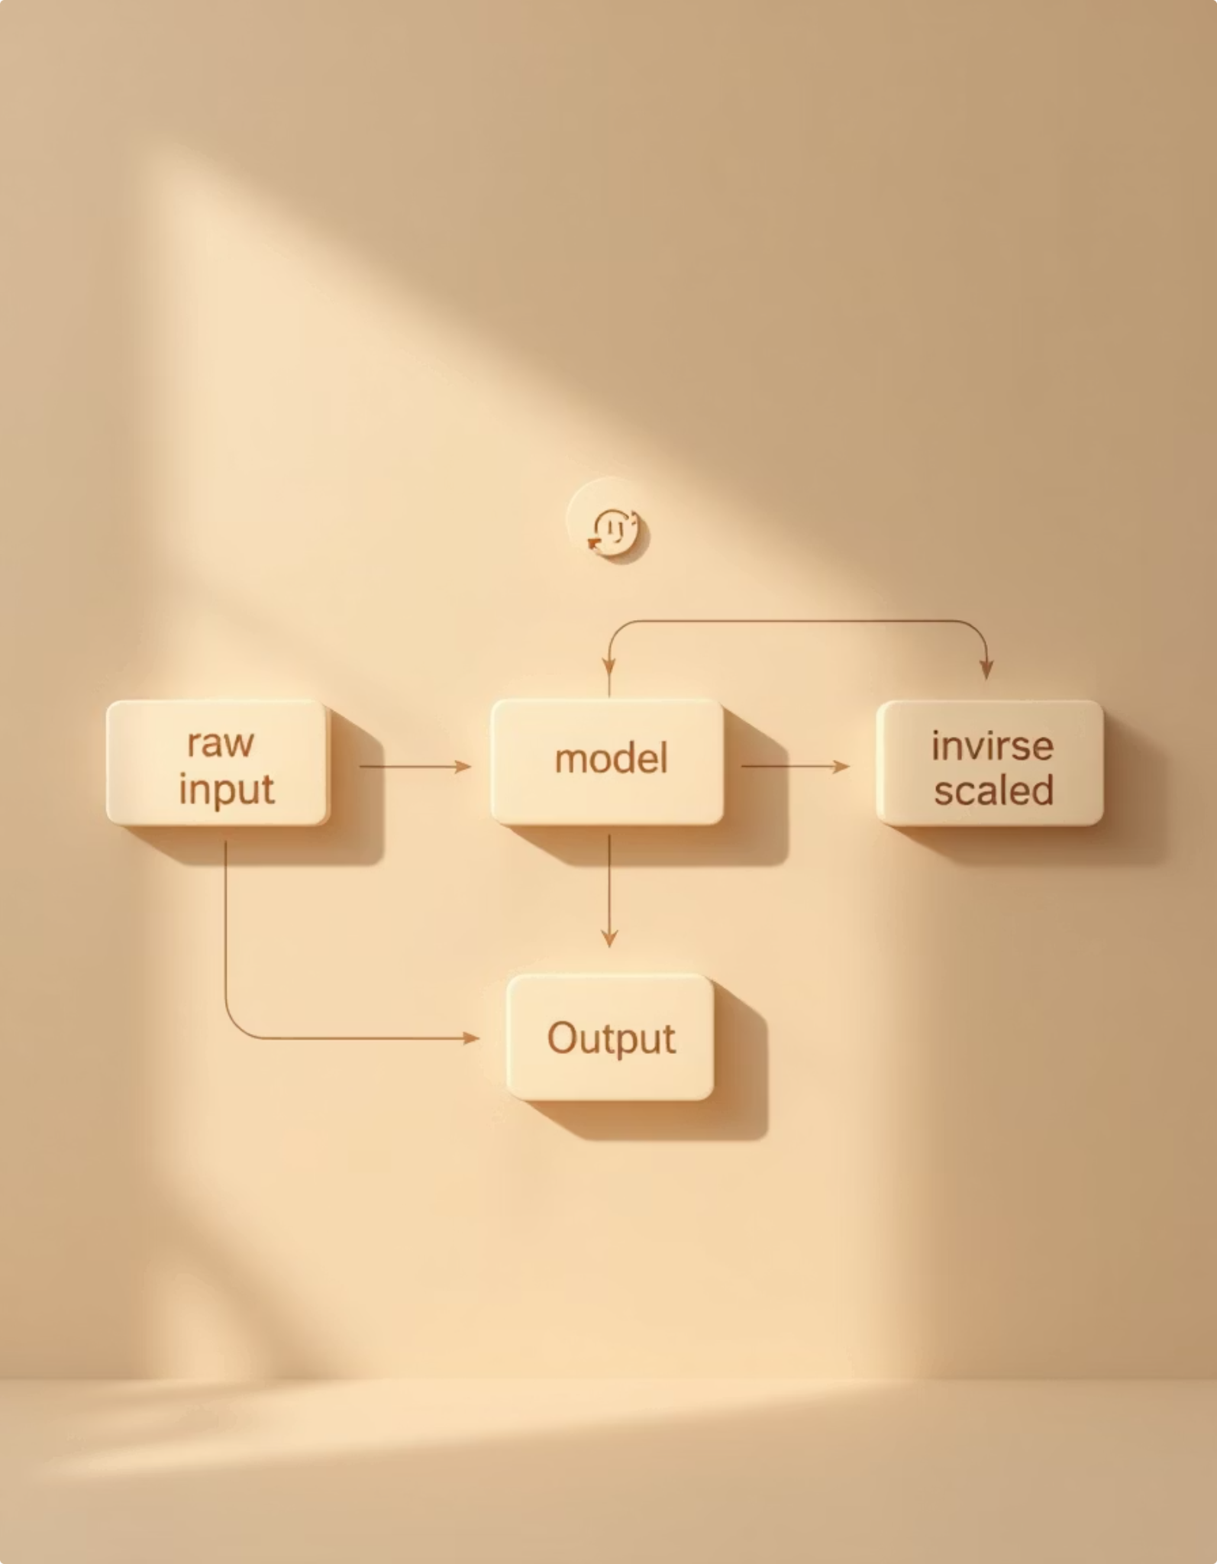

Saving Preprocessing Objects for the Dashboard
For live predictions in your Streamlit dashboard, it's essential to save the exact scaler objects and image scaling parameters used during training. This ensures new user inputs are preprocessed identically to the training data.
import joblib
image_scaling_params = {'perm_min_out': perm_min, 'perm_max_out': perm_max, 'poro_min_out': poro_min, 'poro_max_out': poro_max}
joblib.dump(y_scaler, 'y_scaler_out.gz’)
joblib.dump(num_scaler, 'num_scaler_out.gz’)
joblib.dump(image_scaling_params, 'image_param_out.gz')
These .gz files enable the Streamlit dashboard to scale new inputs and inverse-transform predictions accurately, maintaining consistency between training and deployment environments.

Slide 87




Key Takeaways & Next Steps
Persistent Models
Automate Tuning
Always save your trained models and preprocessing components.
Leverage tools like Optuna for efficient hyperparameter optimization.
Capture History
Streamlit Integration
Save training history for performance monitoring and dashboard visualization.
Ensure all necessary assets are saved for seamless dashboard deployment and live predictions.
Now let's move on to our prediction dashboard

